Slide 1




Injecting constraints into neural NLP models
Jay-Yoon Lee
Thesis committee
Jaime Carbonell (Chair)
William Cohen
Graham Neubig
Dan Roth, University of Pennsylvania
Notes:
Thanks for coming to …
Especially thank committee members taking their time

Slide 2
Injecting constraints into neural NLP models

Slide 3
Constraints?
Injecting constraints into neural NLP models.
Notes:
I talk mainly about hard constraints.
Which can be interchanged with "rules"

Slide 4
Constraints?
Grammar
I are presenting on my thesis proposal.
I am presenting on my thesis proposal.
The keys is on the table.
The keys are on the table.
The keys to the cabinet is on the table.
The keys to the cabinet are on the table.
Linzen et al, Assessing the Ability of LSTMs to Learn Syntax-Sensitive Dependencies, 2016
Notes:
Can be defined just over the sentence itself
Rules for consistency and logical agreement.

Slide 5
Constraints?
Grammar
I are presenting on my thesis proposal.
I am presenting on my thesis proposal.
The keys is on the table.
The keys are on the table.
The keys to the cabinet is on the table.
The keys to the cabinet are on the table.
Constraint violating
If subject, verb do not agree.
(singular/plural)
Linzen et al, Assessing the Ability of LSTMs to Learn Syntax-Sensitive Dependencies, TACL 2016
Notes:
subject is ’singular or plural’
By contrast, the language model trained without explicit grammati- cal supervision performed worse than chance on the harder agreement prediction cases

Slide 6
Constraints?
Image-captioning
Input
(image)
Output
(caption)
A woman is talking on a cell phone.
Rohrbach et al, Object Hallucination in Image Captioning, EMNLP 2018
Notes:
generating relevant caption to the provided input.
As you can see,

Slide 7
Constraints?
Image-captioning
Input
(image)
Constraint violating
If an entity/object not present in the picture appears on the caption.
Output
(caption)
A woman is talking on a cell phone.
A woman is talking on a cell phone while sitting on a bench.
A woman is talking to a mouth.
A woman is talking to a pizza.
Rohrbach et al, Object Hallucination in Image Captioning, EMNLP 2018
Notes:
Constraints can be defined in relation to ’input’ and ‘output’

Slide 8
Constraints?
Image-captioning
Input
(image)
Constraint violating
If an entity/object not present in the picture appears on the caption.
Output
(caption)
A woman is talking on a cell phone.
A woman is talking on a cell phone while sitting on a bench.
A woman is talking to a mouth.
Probably wrong, but would be another constraint.
A woman is talking to a pizza.
Rohrbach et al, Object Hallucination in Image Captioning, EMNLP 2018
Notes:
As we have seen here,
The constraints I look into are the simple, intuitive rules that is defined on output or on input, output relation.

Slide 9
Injecting constraints into neural NLP models

Slide 10
neural NLP
Injecting constraints into neural NLP models.
(Natural Language Processing)
Notes:
Neural models have recorded the state-of-the-art performance across applications
And natural language processing is one of them.

Slide 11


neural NLP
(Input )
English: Have a nice day.
Machine
Translation (automatic)
(output)
Korean: 좋은 하루 되세요!
(Input )
Question &
Answering
Sentence: John broke a window with a hammer.
Question: What did John use to break the window?
(output)
Answer: Hammer
Notes:
NLP is among them.
Widely used around us.
From Machine Translation to question & answering.
perhaps combined with heuristic rules.
So it is interesting to think how we can improve the neurl NLP models.

Slide 12

Typical neural model training
A black box is trained with cross-entropy loss
Maximizing log-likelihood of (input, true output) pair.
Often requires massive amount of data.
$θ$ (model)
X (Input )
Y (output)
Notes:
black box,
because not much of particular modification to the model,
besides input, output representation changes happen in typical neural network training.

Slide 13
Typical neural model training
Black box trained with cross-entropy loss
Maximizing log-likelihood of (input, true output) pair.
Often requires massive dataset. (not very good on small data)
Can we leverage the known constraints?
$θ$ (model)
X (Input )
Y (output)
Notes:
Not just relying on massive data and hoping that your model would learn what you wish model to learn,
Can we force our neural network to learn what we want to learn?

Slide 14
Challenges in injecting constraints
Training set
constraint-satisfying instances (input ,true output)
Thus, constraint is “not explicit” on training set.
Hard to write ‘if-else’ inside black box.
$θ$ (model)
X (Input )
Y (output)
Notes:
Think of the subject-verb agreement example, we would have to first classify all the verb forms & noun forms
On the rule-based model,
this would be very easy.
But, how can we inject constarints into neural network?

Slide 15
Goal of constraint injection
Injection of constraint to
Provide more logical output(constraint-satisfying),
Improve the model performance,
Overcome the data deficiency problem.
Rules/ Constraint
$θ$ (model)
X (Input )
Y (output)
Notes:
During inference time: finding best output given the model
During train time: injecting rules/constraint into the model.

Slide 16
Roadmap
Applications & constraints
Inference with constraints [AAAI 19’]
Learning with constraints [EMNLP 18’]
Proposed Work
New application.
New methods (exploration).
Completed
Work

Slide 17
Considered Application
Transduction (toy)
A transducer (T) is a function from a ‘source language’ (L_{s} ) to a ‘target language’ (L_{T} ).

Slide 18
Transduction constraints
Transduction (toy)
A transducer (T) is a function from a ‘source language’ (L_{s} ) to a ‘target language’ (L_{T} ).
Multiple (input, output) pairs
[Source] azazbz
[Target] aaaaaazb
[Source] azbzazbzbzaazbzbzbzbzbz
[Target] aaazbaaazbzbaaaaaazbzbzbzbzb
…
Notes:
Source & target both only are comprised of {‘a’, ‘b’, ‘z’}

Slide 19
Transduction constraints
Transduction (toy)
A transducer (T) is a function from a ‘source language’ (L_{s} ) to a ‘target language’ (L_{T} ).
e.g. )
T: az → aaa
bz → zb
S: azazbzazbzbzazbzbzbzbzbz
T: aaaaaazbaaazbzbaaazbzbzbzbzb
constraint:
3 x (# a in S) = # a in T
Notes:
We will examine even this simplest constraint would work using the proposed methods.
---------------
The training set comprises 1934 sequences of length 2–20 and the test set contain sentences of lengths 21-24.
network fails to learn this constraint because doing so would require counting and memo- rizing the number of input a0s over long sequences of characters.

Slide 20
Considered Applications in NLP
Syntactic Parsing
Finding structure of the provided (input) sentence.
S
Tree
NP
VP
.
Parser
John
NP
has
Equivalent
information
a
dog
X (Input )
Y (output)
John has a dog .
(S (NP xx) (VP xx (NP xx xx))
Linearized Tree

Slide 21
Considered Applications in NLP
Syntactic Parsing
Finding structure of the provided (input) sentence.
S
Tree
NP
VP
.
Parser
John
NP
has
Equivalent
information
a
dog
X (Input )
Y (output)
John has a dog .
(S (NP xx) (VP xx (NP xx xx))
Linearized Tree
To use Sequence-to-Sequence model:
models relationship between sequence input & sequence output.

Slide 22
Constraints in Parsing
Syntactic Parsing
Finding structure of the provided (input) sentence.
Parser
John has a dog
True:
(S (NP xx) (VP xx(NP xx xx))
Others:
(S (NP xx) (VP xx (NP xx xx))) ))
( (S (NP xx) (VP xx (NP xx xx))
(S (NP xx) ) )(VP xx (NP xx xx)))
(S (NP xx xx xx xx xx))
(S (NP xx) (VP xx xx xx))
Now you use seq2seq model,
The model might generate constraint-violating outputs
Notes:
opening # of brackets,
closing # of brackets don't match

Slide 23
Constraints in Parsing
Syntactic Parsing
Finding structure of the provided (input) sentence.
Parser
John has a dog
True:
(S (NP xx) (VP xx(NP xx xx))
Constraint:
“# open - # closing bracket = 0”
“# of input tokens has to match # of children on the tree”
Others:
(S (NP xx) (VP xx (NP xx xx))) ))
( (S (NP xx) (VP xx (NP xx xx))
(S (NP xx) ) )(VP xx (NP xx xx)))
(S (NP xx xx xx xx xx))
(S (NP xx) (VP xx xx xx))
Notes:
and also # of input tokens,
has to match # of children on the tree.

Slide 24
Constraints in Parsing
Syntactic Parsing
Finding structure of the provided (input) sentence.
Parser
John has a dog
True:
(S (NP xx) (VP xx(NP xx xx))
Output space intrinsic
Constraint:
“# open - # closing bracket = 0”
“# of input tokens has to match # of children on the tree”
Others:
(S (NP xx) (VP xx (NP xx xx))) ))
( (S (NP xx) (VP xx (NP xx xx))
(S (NP xx) ) )(VP xx (NP xx xx)))
(S (NP xx xx xx xx xx))
(S (NP xx) (VP xx xx xx))
(Input, output)
relation
Notes:
and also # of input tokens,
has to match # of children on the tree.

Slide 25
Considered Applications in NLP
Semantic Role Labeling (SRL)
Finding ( Agent (arg0), Patient (arg1) ) given verb
SRL
X (Input )
Y (output)
John broke the window with a hammer.
verb: broke
ARG0: John
ARG1: the window
ARG2: a hammer
Notes:
john agent
window patinet
and tool is a hammer.

Slide 26


Semantic Role Labeling
Application 1: Semantic Role Labeling (SRL)
Finding ( Agent (arg0), Patient (arg1) ) given verb
subj
V
obj
John broke the window with a hammer.
agent
(actor of an action)
patient
(entity affected by the action)
instrument
(tool used in performing action)
Slide credits: Sanket Metha
Notes:
A bit of explanation on imitation learning

Slide 27
Semantic Role Labeling
Application 1: Semantic Role Labeling
Finding ( Agent (arg0), Patient (arg1) ) given verb
Core Roles: Verb specific roles (ARG0, ARG1, …, ARG5)
Adjunct roles: Shared across all verbs
subj
V
obj
Verb: break
John broke the window with a hammer.
Role | Description
ARG0 | breaker (agent)
ARG1 | thing broken (patient)
ARG2 | instrument used
... | ...
Role | Description
ARGM-TMP | temporal
ARGM-DIR | direction
ARGM-LOC | location
... | ...
agent
(actor of an action)
patient
(entity affected by the action)
instrument
(tool used in performing action)
Slide credits: Sanket Metha
Notes:
A bit of explanation on imitation learning

Slide 28
Application using SRL
Question answering (5W1H)
“Who” questions usually use Agents. (Arg0)
“What” questions usually use Patients. (Arg1)
“How” and “with what” questions usually use Instruments. (Arg2)
“Where” questions frequently use Sources and Destinations . (ARGM-LOC)
“For whom” questions usually use Benefactives. (Arg1)
“To whom” questions usually use Destinations.
Slide credits: Sanket Metha
Notes:
As many of the answers to question corresponds to SRL arguments,
We can simply run SRL to answer questions OR use it to prune the answer candidatess

Slide 29

Semantic Role Labeling
Application 1: Semantic Role Labeling
Finding ( Agent (arg0), Patient (arg1) ) given verb
SRL
X (Input )
Y (output)
John broke the window with a hammer.
verb: broke
ARG0: John
ARG1: the window
ARG2: a hammer
Notes:
And again, because we are doing neural network,
we have this black box for SRL

Slide 30
Complex task
Complex task (sometimes) is sometimes easier to model when the task is divided into multiple ones
model1
model2
Z
X (Input )
Y (output)

Slide 31
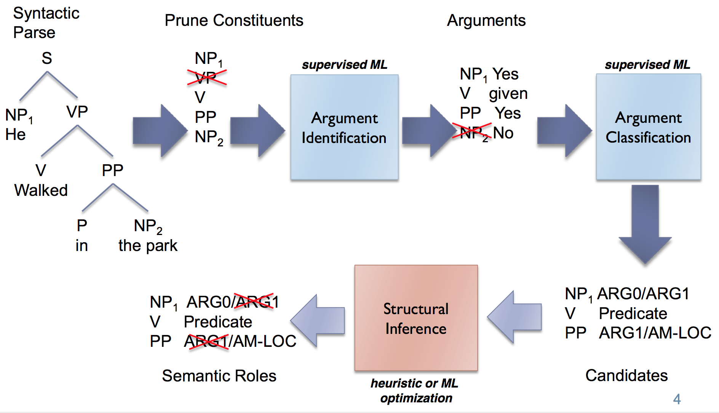
Complex models - example
Semantic Role Labeling (step by step)
X (Input )
“He walked in the park”
Y (output)
VERB – walked
ARG0 – He
LOC– in the park
Notes:
Use combinatorial search (or proper optimization) to find correct Roles for candidate spans.
You can view SRL as an multi-task problem
of chunking to get proper spans,
and classification problem for argument lables.

Slide 32
Complex models - example
Model 1
Model 2
Semantic Role Labeling
X (Input )
“He walked in the park”
Y (output)
VERB – walked
ARG0 – He
LOC– in the park
Model3
Notes:
Model1: Proper candidates

Slide 33
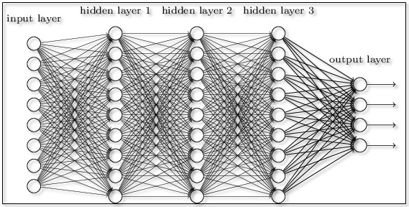
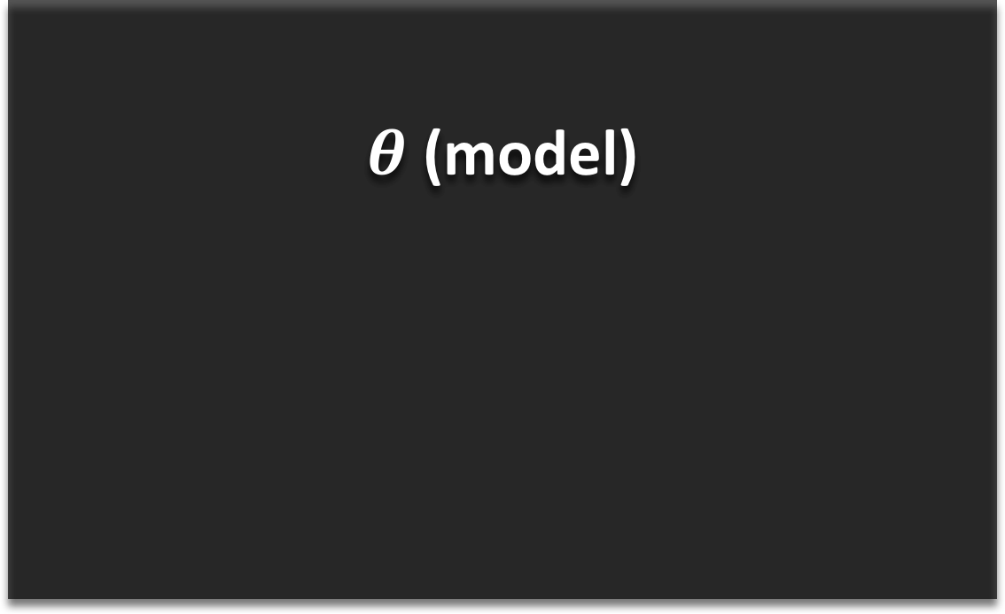
Complex models to End-to-End
End-to-end Semantic Role Labeling.
Neural models often perform better on end-to-end learning.
$θ$ (model)
X (Input )
“He walked in the park”
Y (output)
VERB – walked
ARG0 – He
LOC– in the park

Slide 34
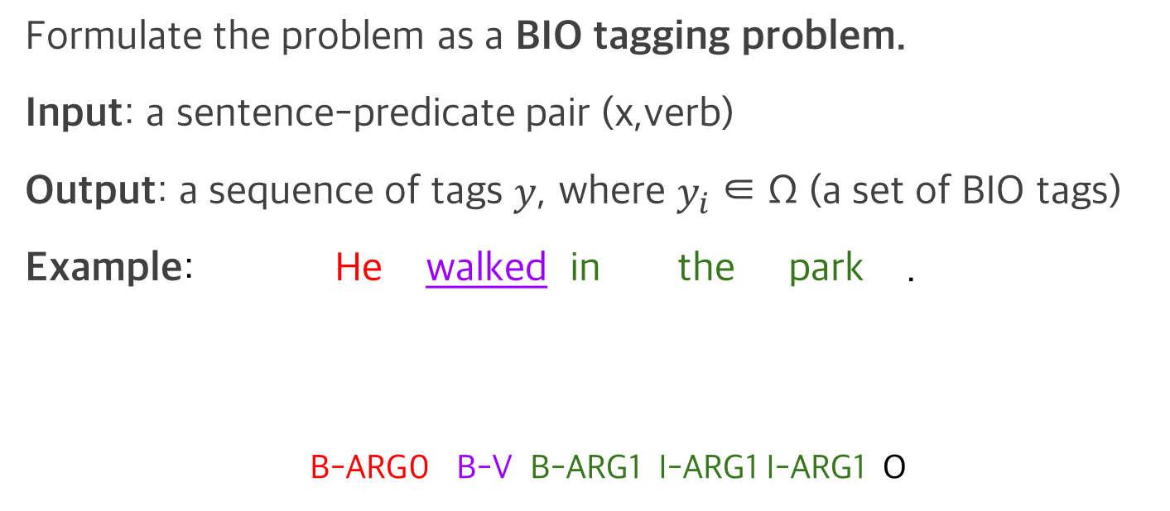
How to solve it?
Formulate the problem as a BIO tagging problem.
Input: a sentence-predicate pair (x,verb)
Output: a sequence of tags $y$, where $y_{i}$ ∈ Ω (a set of BIO tags)
Example: He walked in the park .
B-ARG0 B-V B-ARG1 I-ARG1 I-ARG1 O
SRL System
Slide credits: Sanket Metha
Notes:
A bit of explanation on imitation learning

Slide 35
What are different constraints for SRL task?
BIO constraints
Constraint violation: B-ARG0 followed by I-ARG1
(similar to the constraints in Parsing example)
SRL constraints (as defined by Punyakanok et al. (2008))
Unique core roles (U)
Continuation roles (C)
Reference roles (R)
Syntactic constraints
Constraint violation: Arguments that are not constituents within a given parse tree
Slide credits: Sanket Metha

Slide 36
Syntactic constraint on SRL
Given syntax tree, span candidates were limited by syntactic information.
X (Input )
Possible span candidate
“He walked in the park”
(He), (walked), (in the park),
(walked in the park), (He walked in the park)
(He) (walked) (in the park)

Slide 37
Syntactic constraint on SRL
Given syntax tree, span candidates were limited by syntactic information.
X (Input )
Possible span candidate
“He walked in the park”
(He), (walked), (in the park),
(walked in the park), (He walked in the park)
(He) (walked) (in the park)
(He) (walked in)(the park)
(He walked) (in the park)
(He walked in the)(park)
(He walked in the park)
However, end-to-end model without syntactic information can generate
all possible “spans” given sentence.

Slide 38
Syntactic constraint on SRL
Given syntax tree, span candidates were limited by syntactic information.
X (Input )
Possible span candidate
“He walked in the park”
(He), (walked), (in the park),
(walked in the park), (He walked in the park)
(He) (walked) (in the park)
(He) (walked in)(the park)
(He walked) (in the park)
(He walked in the)(park)
(He walked in the park)
However, end-to-end model without syntactic information can generate
all possible “spans” given sentence.

Slide 39
Syntactic constraint on SRL
Given syntax tree, span candidates were limited by syntactic information.
X (Input )
Possible span candidate
“He walked in the park”
(He), (walked), (in the park),
(walked in the park), (He walked in the park)
(He) (walked) (in the park)
(He) (walked in)(the park)
(He walked) (in the park)
(He walked in the)(park)
(He walked in the park)
However, end-to-end model without syntactic information can generate
all possible “spans” given sentence.
Constraint-violating
Notes:
Cutting in-between the sub-tress,
Rather than enclosing it.

Slide 40
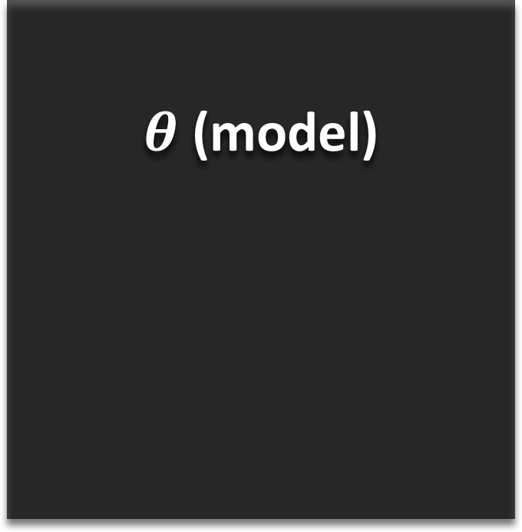
Inference using constraint
Inference: Finding the best output given the model.
$θ$ (model)
X (Input )
“He walked in the park”
Post Processing
Constraint
Y (output)
VERB – walked
ARG0 – He
LOC– in the park
Notes:
With these applications & constraints,
I am going to explore
Inference
Learning With constraints

Slide 41
Inference using constraint
Proper “Injection of constraints” on Inference step.
$θ$ (model)
X (Input )
“He walked in the park”
Post Processing
Constraint
Y (output)
VERB – walked
ARG0 – He
LOC– in the park
Notes:
(more than simply filtering out violating output)

Slide 42
Learning with constraints
Proper “Injection of constraints” to the model in learning time.
$θ$ (model)
X (Input )
“He walked in the park”
Injection
Knowledge/ Constraint
Y (output)
VERB – walked
ARG0 – He
LOC– in the park

Slide 43
Roadmap
Applications & constraints
Inference with constraints [AAAI 19’]
Learning with constraints [EMNLP 18’]
Proposed Work
New application.
New methods (exploration).
Completed
Work

Slide 44
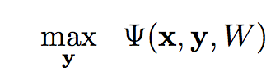
Gradient-Based Inference* (GBI)
Inference
Finding the output with the highest model probability.
Learned model
Lee et al, Gradient-based Inference for Networks with Output Constraint, AAAI 2019
Notes:
Next: To express this constraint satisfaction esaily,

Slide 45
Gradient-Based Inference* (GBI)
Inference
Finding the output with the highest model probability.
Given length m, vocabulary size V, the search space becomes V^m.
Viterbi decoding (exact)
Sequence-to-sequence models have no limit to length m, thus the search space is larger.
Greedy decoding, beam decoding
Lee et al, Gradient-based Inference for Networks with Output Constraint, AAAI 2019
Notes:
Discrete sequence search problem
Approximate
Next: To express this constraint satisfaction esaily,

Slide 46
Constraint function
Constraint (evaluation) function. (Error counting)
no constraint violation
Notes:
Define a positive constraint function $g$.
0 if and only if
there is no constraint violation

Slide 47
Constraint function
Constraint evaluation function. (degree of error, higher the more error)
no constraint violation
Optimization with constraints
Constraint
for feasible set L^{x}
Notes:
Rewriting the optimization function

Slide 48
Gradient-Based Inference* (GBI)
Inference with constriant
Finding the output with the highest model probability given (local, global )constraint.
Given length m, vocabulary size V, the search space becomes V^m.
Viterbi decoding (exact), A* algorithm (DP)
Sequence-to-sequence models have no limit to length m, thus the search space is larger.
Greedy decoding, beam decoding
constraint
Lee et al, Gradient-based Inference for Networks with Output Constraint, AAAI 2019
Notes:
Next: To express this constraint satisfaction esaily,

Slide 49
Gradient-Based Inference* (GBI)
Inference with constriant
Finding the output with the highest model probability given (local, global )constraint.
Given length m, vocabulary size V, the search space becomes V^m.
Viterbi decoding (exact), A* algorithm (inexact DP)
Sequence-to-sequence models have no limit to length m, thus the search space is larger.
Greedy decoding, beam decoding
Lee et al, Gradient-based Inference for Networks with Output Constraint, AAAI 2019
Notes:
Inexact Dynamic Programing

Slide 50
Gradient-Based Inference* (GBI)
Inference with constriant
Finding the output with the highest model probability given (local, global )constraint.
Given length m, vocabulary size V, the search space becomes V^m.
Viterbi decoding (exact), A* algorithm (inexact DP)
Sequence-to-sequence models have no limit to length m, thus the search space is larger.
Approximate by greedy decoding, beam decoding
Very slow on exponential search space
Fast but Localized appraoch thus not suitable for the ‘global’ constraint. (not localizeable)
Lee et al, Gradient-based Inference for Networks with Output Constraint, AAAI 2019
Notes:
Not localizeable like the parsing example.
or not global, but fairly long sequence dependency.

Slide 51
Gradient-Based Inference (GBI)
Optimization with constraints
Notes:
Throw in some neural network equations h_t = f(W*x_t)

Slide 52
Gradient-Based Inference (GBI)
Optimization with constraints
Gradient-Based Inference (in math)
Combinatorial problem.
Can we search faster
by changing model weights?
Notes:
by tweaking the model weights
as we want.

Slide 53
Gradient-Based Inference (GBI)
Motivation
Optimization with constraints
Gradient-Based Inference
Likelihood
Constraint violation
Notes:
minimizing probabilities of example
that are constraint violating,
but may go to trivial solution
or
may forget what it learned before,

Slide 54
Gradient-Based Inference (GBI)
Motivation
Optimization with constraints
Gradient-Based Inference
Learned model weight
Expected
constraint violation
Regularizer
Notes:
This is instance-based optimization,
so we reset and make W_l to be W again
for new example.

Slide 55
Gradient-Based Inference (GBI)
Motivation
Optimization with constraints
Gradient-Based Inference (in math)
Standard Lagrangian
Very slow. (combinatorial) Especially global constraint
Greedy, beam-search relatively fast
Notes:
Throw in some neural network equations h_t = f(W*x_t)

Slide 56
Gradient-Based Inference (GBI)
Motivation
Optimization with constraints
Gradient-Based Inference (in math)
Standard Lagrangian
Combinatorial problem.
Very slow. (combinatorial) Especially global constraint
Now, with expected constraint violation,
we can “reflect” global constraints.
Using the two, can we search faster
by changing model weights?
Greedy, beam-search relatively fast
Notes:
as opposed traversing simply on
the output space as usual?

Slide 57
Research Questions
Q1. Does GBI actually enforce constraints?
Q2. Does GBI enforce constraints without compromising the quality of the system?
Q3. Can GBI work over multiple baseline model?
Q4. Performance of GBI on out-of-domain dataset?
Notes:
Throw in some neural network equations h_t = f(W*x_t)

Slide 58
Research Questions
Q1. Does GBI actually enforce constraints?
Q2. Does GBI enforce constraints without compromising the F1 score of the system?
Q3. Can GBI generalize over multiple baseline model?
Q4. Performance of GBI on out-of-domain dataset?
Notes:
Throw in some neural network equations h_t = f(W*x_t)

Slide 59
Research Questions
Q1. Does GBI actually enforce constraints?
Q2. Does GBI enforce constraints without compromising the F1 score of the system?
Q3. Can GBI generalize over multiple baseline model?
Q4. Performance of GBI on out-of-domain dataset?
Notes:
Throw in some neural network equations h_t = f(W*x_t)

Slide 60
Research Questions
Q1. Does GBI actually enforce constraints?
Q2. Does GBI enforce constraints without compromising the F1 score of the system?
Q3. Can GBI generalize over multiple baseline model?
Q4. Performance of GBI on out-of-domain dataset?
Notes:
Throw in some neural network equations h_t = f(W*x_t)

Slide 61
Research Questions
Q1. Does GBI actually enforce constraints?
Q2. Does GBI enforce constraints without compromising the F1 score of the system?
Q3. Can GBI generalize over multiple baseline model?
Q4. How is the performance of GBI on out-of-domain dataset?
Notes:
Throw in some neural network equations h_t = f(W*x_t)

Slide 62
Back to SRL
Revisiting Semantic Role Labeling (SRL)
Finding ( Agent (arg0), Patient (arg1) ) given verb
SRL
X (Input )
Y (output)
“He walked in the park”
VERB – walked
ARG0 – He
LOC– in the park
Notes:
Throw in some neural network equations h_t = f(W*x_t)

Slide 63
Syntactic constraint on SRL
Given syntax tree, span candidates were limited by syntactic information.
X (Input )
Possible span candidate
“He walked in the park”
(He), (walked), (in the park),
(walked in the park), (He walked in the park)
(He) (walked) (in the park)
(He) (walked in)(the park)
(He walked) (in the park)
(He walked in the)(park)
(He walked in the park)
Wrong spans marked with strike
Notes:
As we discussed, let’s define the constraint function

Slide 64
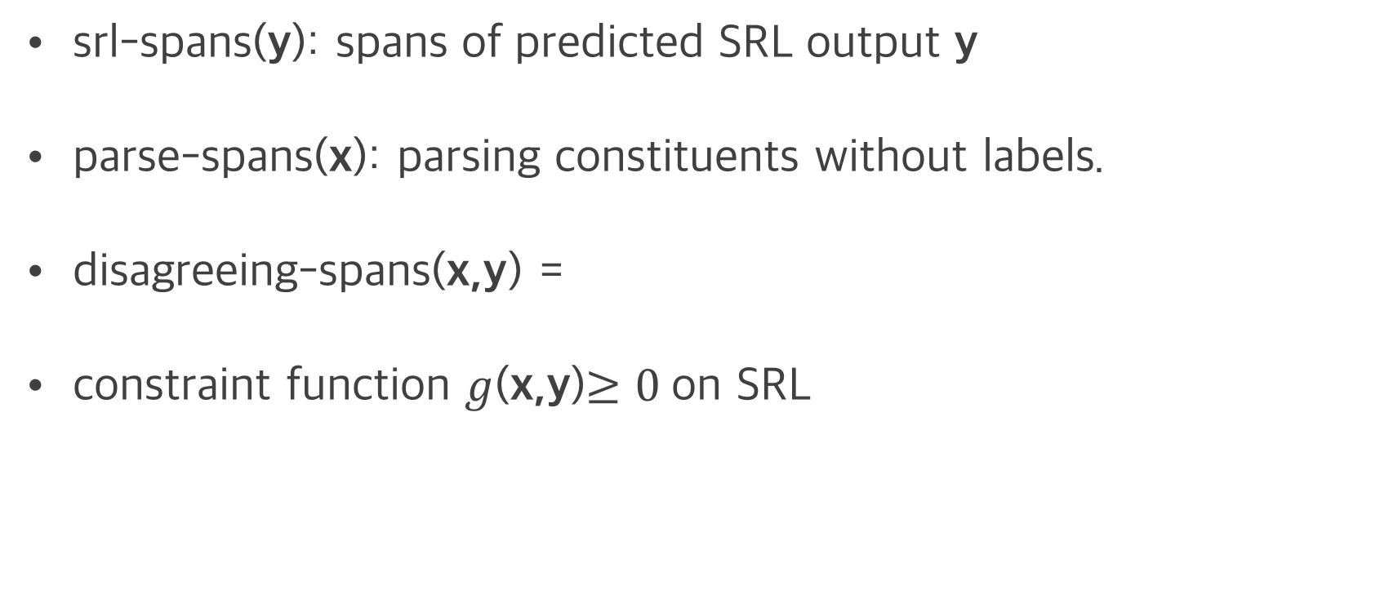
Constraint on SRL
srl-spans(y): spans of predicted SRL output y
parse-spans(x): parsing constituents without labels.
disagreeing-spans(x,y) =
constraint function $g$(x,y)$≥0$on SRL

Slide 65
Constraint on SRL
Constraint (violation) scores on previous exmaple
Possible span candidate
(He), (walked), (in the park),
(walked in the park), (He walked in the park)
X (Input )
“He walked in the park”
g(x,y)
0.0
0.33
0.5
1.0
0.0
(He) (walked) (in the park)
(He) (walked in)(the park)
(He walked) (in the park)
(He walked in the)(park)
(He walked in the park)
Assign scores to the constraint- violating output
Y (output)
VERB – walked
ARG0 – He
LOC– in the park

Slide 66
GBI on SRL: Experiments
OntoNotes v5.0, CoNLL-2012 shared task (278k train, 38.3k dev, 25.6k test)
Gold predicates and gold parse constituents are given (~10% noisy annotations) .
Baseline architecture
multi-layer highway bi-directional LSTM (ELMo embedding)
Notes:
With the defined constraints,
And with the proposed GBI

Slide 67
GBI on SRL: Experiments
Statistics
Failure set: Set of instances where SRL output violates simple constraint.
Failure rate (%): Relative size of failure set compared to whole test set.
Conv rate (%): The relative portion of the failure set converted to constraint-satisfying output after GBI.
Notes:
GBI only affects the ones that has failures.

Slide 68
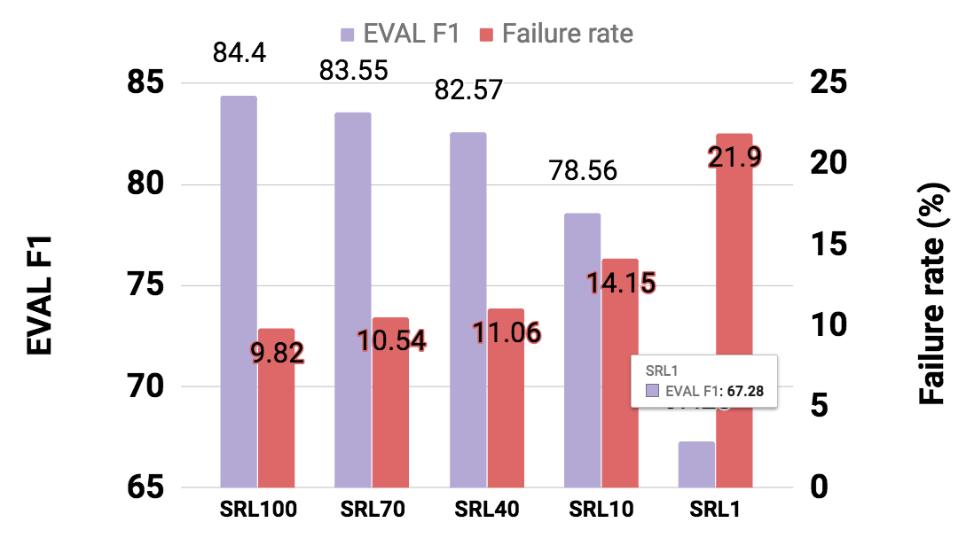
GBI on SRL: Experiments
Trained 5 networks with different level of performance by using different amounts of data (1%,10%, …,100%)
SRL x : SRL system trained on x % data.

Slide 69
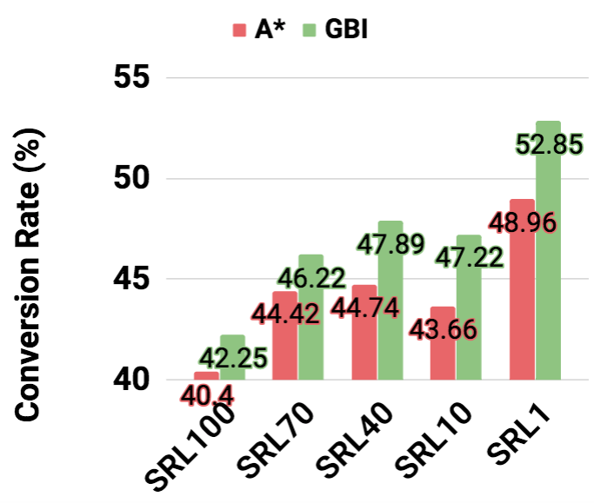
GBI on SRL: Experiments
Q3: GBI enforces constraints. (much better than A*)

Slide 70
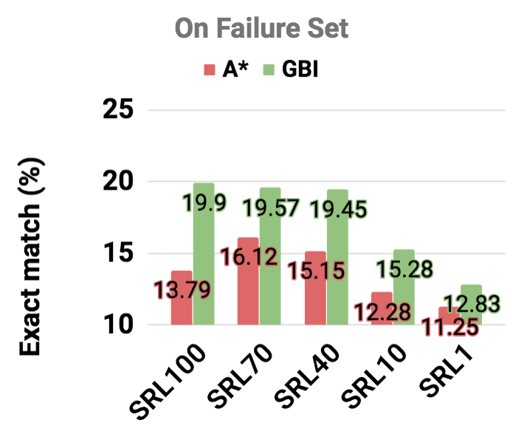
GBI on SRL: Experiments
Q3: GBI enforces constraints without hurting the system.
On Failure Set
SRL x : SRL system trained on x % data.

Slide 71
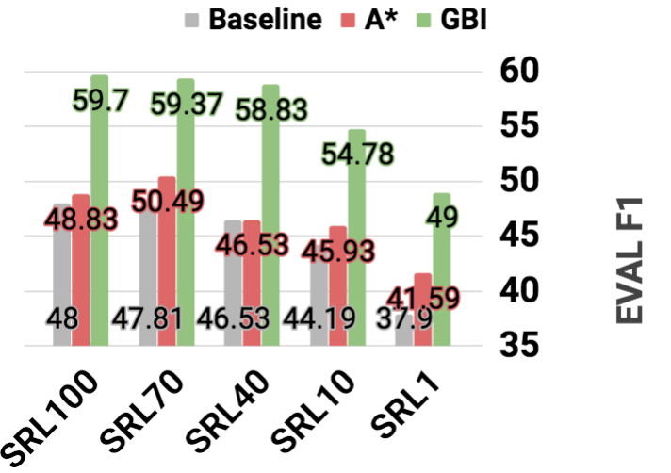
GBI on SRL: Experiments
Q3: GBI enforces constraints without hurting the system.
In fact, it improves the overall system performance
On Failure Set
SRL x : SRL system trained on x % data.

Slide 72
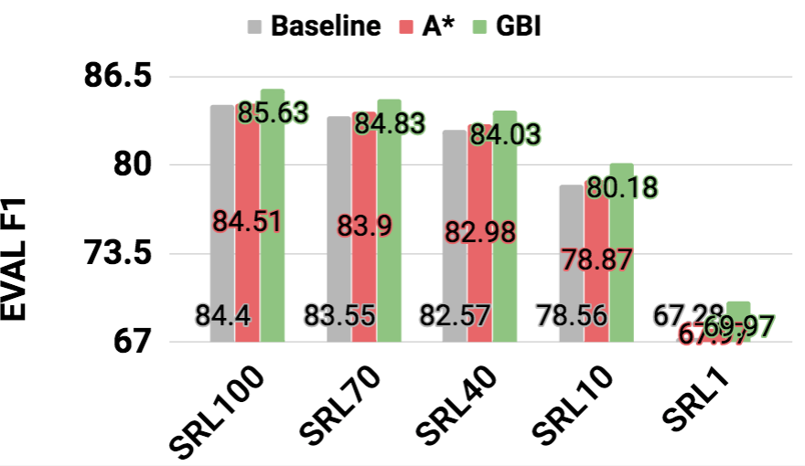
GBI on SRL: Experiments
Q3: GBI enforces constraints without hurting the system.
In fact, it improves the overall system performance
On Total test set
SRL x : SRL system trained on x % data.

Slide 73
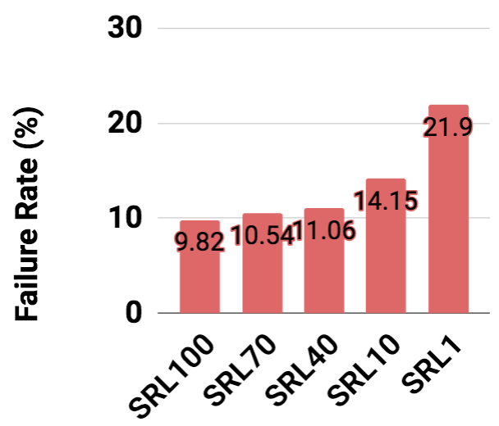
GBI on SRL: Experiments
Q4: Not sensitive to the baseline model performance
On Failure Set
Notes:
Q5 will be dealt later.

Slide 74
Application 2: Syntactic Parsing
By a linguist
Deterministic rule based. (thousands of rules)
Statistical methods
O(N³) and accurate
O(N) and inaccurate
State of the art: Neural Networks.
Using generic sequence-to-sequence model
Using span-based models
Notes:
A bit of explanation on imitation learning

Slide 75
Constraints on parsing model
seq2seq does not guarantee “very simple rule”.
Parser
John has a dog
True:
(S (NP xx) (VP xx(NP xx xx))
Rules:
“# open - # closing bracket = 0”
“# of input tokens has to match # of children on the tree”
Others:
(S (NP xx) (VP xx (NP xx xx))) ))
( (S (NP xx) (VP xx (NP xx xx))
(S (NP xx) ) )(VP xx (NP xx xx)))
(S (NP xx xx xx xx xx))
(S (NP xx) (VP xx xx xx))
Notes:
A bit of explanation on imitation learning

Slide 76
Constraints function
Rules
# of input tokens = # of children on output tree
# opening brackets = # of closing brackets
Constraint function definition (x:input, y: output)
Simple count of errors normalized by sum of input, output length.
Roughly speaking:
Notes:
(S (NP xx) (VP xx(NP xx xx))

Slide 77
GBI on parsing: Experiments
Trained 5 parsers to answer Q1-4 (especially Q3)
Net1-2: GNMT (bi-directional encoder, uni-directional decoder)
Net3-5: uni-directional encoder, decoder.
Different dropout, used different portion of the dataset.
GNMT: Wu et al, Google's Neural Machine Translation System: Bridging the Gap between Human and Machine Translation, 2016
Notes:
A bit of explanation on imitation learning

Slide 78
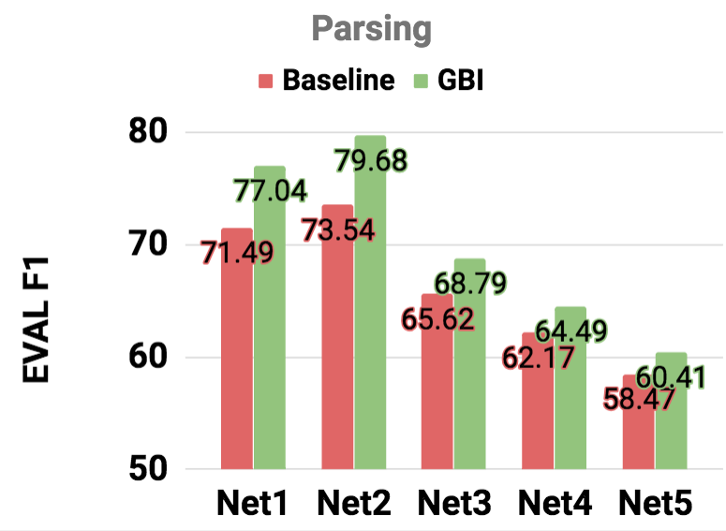
GBI on parsing: Experiments
Similar trend.
Again, GBI
Improves all cases.
Notes:
A bit of explanation on imitation learning

Slide 79
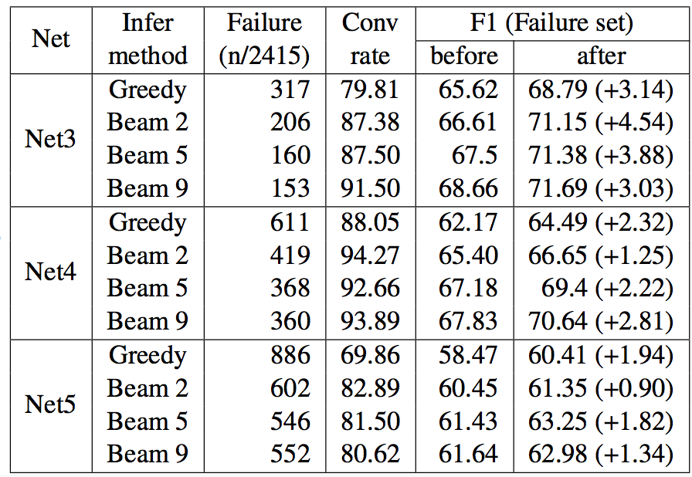
GBI on parsing: Experiments
Q4: Not sensitive to the baseline model performance.
Not only that, GBI is also compatible with various decoding methods.
Notes:
A bit of explanation on imitation learning

Slide 80
GBI on parsing: Experiments
Q4: Not sensitive to the baseline model performance.
Not only that, GBI is also compatible with various decoding methods.
More details,
Please refer to
the thesis proposal.
Notes:
A bit of explanation on imitation learning

Slide 81
GBI on transducer
Transduction (toy)
A transducer (T) is a function from a ‘source language’ (L_{s} ) to a ‘target language’ (L_{T} ).
T: az → aaa
bz → zb
Experiment Result
65.2% conversion rate
On Failure set
Before-GBI: 75.2%
After-GBI: 82.4%
S: azazbzazbzbzazbzbzbzbzbz
T: aaaaaazbaaazbzbaaazbzbzbzbzb
constraint:
3 x (# a in S) = # a in T
Notes:
Even this simplistic constraint work.
The training set comprises 1934 sequences of length 2–20 and the test set contain sentences of lengths 21-24.
network fails to learn this constraint because doing so would require counting and memo- rizing the number of input a0s over long sequences of characters.

Slide 82
GBI on transducer
Transduction (toy)
A transducer (T) is a function from a ‘source language’ (L_{s} ) to a ‘target language’ (L_{T} ).
T: az → aaa
bz → zb
Experiment Result
65.2% conversion rate
On Failure set (accuracy)
Before-GBI: 75.2%
After-GBI: 82.4%
S: azazbzazbzbzazbzbzbzbzbz
T: aaaaaazbaaazbzbaaazbzbzbzbzb
constraint:
3 x (# a in S) = # a in T
More details,
Please refer to
the thesis proposal.
Notes:
Even this simplistic constraint work.
The training set comprises 1934 sequences of length 2–20 and the test set contain sentences of lengths 21-24.
network fails to learn this constraint because doing so would require counting and memo- rizing the number of input a0s over long sequences of characters.

Slide 83
GBI: extra considerations
Robustness to noisy constraint.
Q5) out-of-domain performance.
Notes:
Throw in some neural network equations h_t = f(W*x_t)

Slide 84
Robustness of GBI
SRL has about 10% of the span mismatch between annotated SRL output (propbank) & parse tree (treebank)
Notes:
Throw in some neural network equations h_t = f(W*x_t)

Slide 85
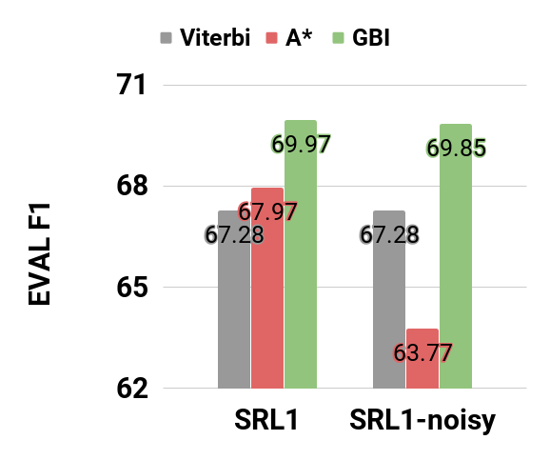
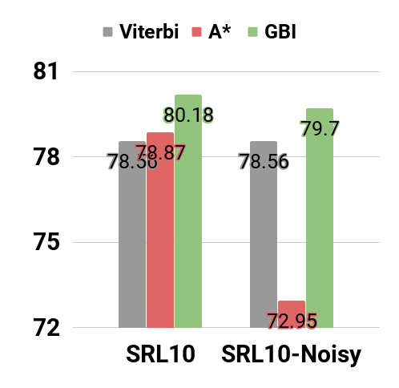
Robustness of GBI
SRL has about 10% of the span mismatch between annotated SRL output (propbank) & parse tree (treebank)
1% - trained
10% - trained
Notes:
Throw in some neural network equations h_t = f(W*x_t)

Slide 86
Robustness of GBI
SRL has about 10% of the span mismatch between annotated SRL output (propbank) & parse tree (treebank)
1% - trained
10% - trained
Noise hurts A* but not much on GBI
Notes:
GBI not only works better than A*
It is far more robust than A*

Slide 87
GBI on out-of-domain data (Q5)
CoNLL2012
NewsWire (NW)
Broadcast Conversation (BC)
Broadcast News (BN)
Pivot Corpus (PT)
Telephone Conversation (TC)
Weblogs (WB)
Notes:
Throw in some neural network equations h_t = f(W*x_t)

Slide 88
GBI on out-of-domain data
CoNLL2012
NewsWire (NW) which includes WSJ
Broadcast Conversation (BC)
Broadcast News (BN)
Pivot Corpus (PT)
Telephone Conversation (TC)
Weblogs (WB)
Source
Domain
Constraint
Target
Domain
Can constraint injection
transfer to other domains?
Notes:
Throw in some neural network equations h_t = f(W*x_t)

Slide 89
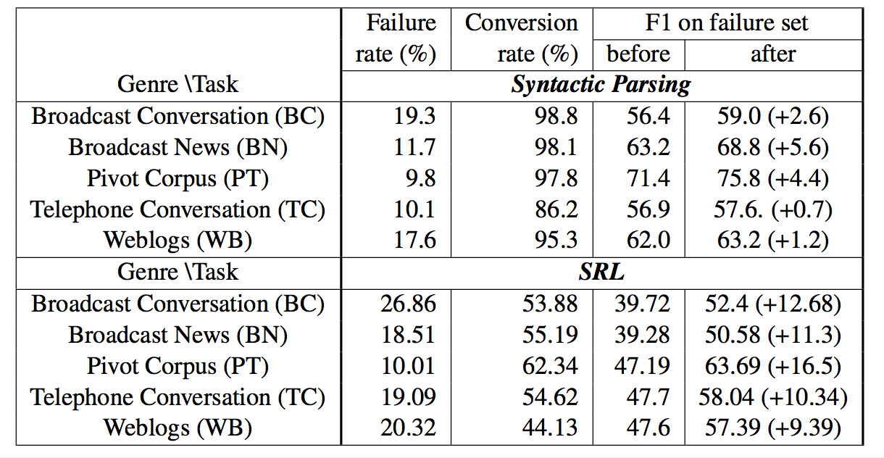
GBI on out-of-domain data
Generally higher failure rate on out-of-domain evaluation compared to in-domain (parsing: 11.9 %, SRL: 18.1%).
Notes:
Throw in some neural network equations h_t = f(W*x_t)

Slide 90
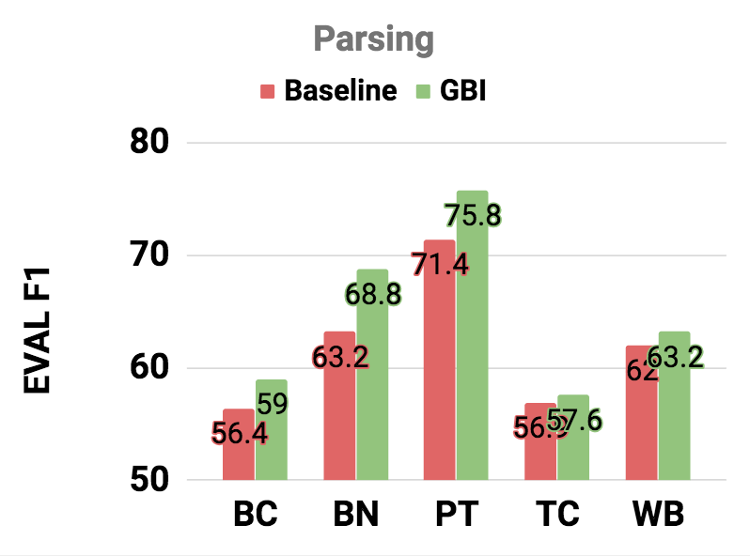
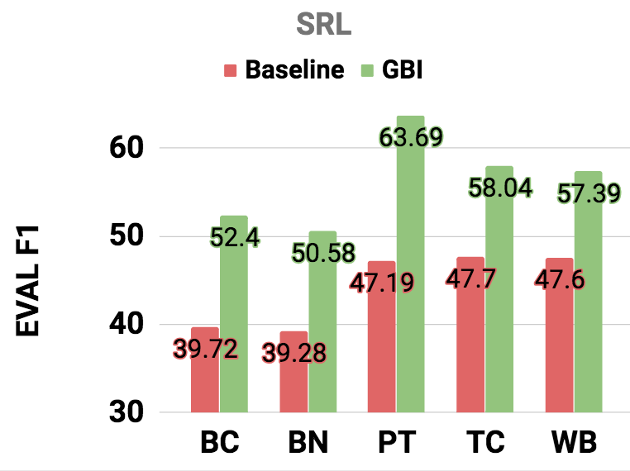
GBI on out-of-domain data
In summary, improves in all cases (reporting on failure set)
While parsing is more sensitive to domains.
Notes:
Throw in some neural network equations h_t = f(W*x_t)

Slide 91

Research Questions
Q1. Does GBI actually enforce constraints?
Yes!
Q2. Does GBI enforce constraints without compromising the quality of the system?
Yes. It rather Improves!
Q3. Is GBI sensitive to the baseline model?
Not on 3 applications (5 experiment settings)
Q4. Performance of GBI on out-of-domain dataset?
Good!
Notes:
Throw in some neural network equations h_t = f(W*x_t)

Slide 92
Roadmap
Applications & constraints
Inference with constraints [AAAI 19’]
Learning with constraints [EMNLP 18’]
Related Work
Proposed Work
New application.
New methods (exploration).
Completed
Work

Slide 93
Learning with constraints
Standard approach:“Post-processing”
$θ$ (model)
X (Input )
“He walked in the park”
Post-processing
Knowledge/ Constraint
Y (output)
VERB – walked
ARG0 – He
LOC– in the park

Slide 94

Learning with constraints
“Injection of knowledge” beyond “Post-processing”.
$θ$ (model)
X (Input )
“He walked in the park”
Injection
Knowledge/ Constraint
Y (output)
VERB – walked
ARG0 – He
LOC– in the park

Slide 95
Learning with constraints
Post-processing still can be done the same way.
But would post processing help as much as before? (Q4)
$θ$ (model)
X (Input )
“He walked in the park”
Injection
Knowledge/ Constraint
Post- processing
Y (output)
VERB – walked
ARG0 – He
LOC– in the park

Slide 96

Learning with constraints
Standard Learning
minimizing negative log-likelihood
Learning with the reward:
Reward defined by our constraint.
Motivation:
Can we use how well (or how bad) the model satisfies the constraint as a signal to learn further?
$θ$ (model)
X (Input )
Y (output)
Notes:
Throw in some neural network equations h_t = f(W*x_t)

Slide 97
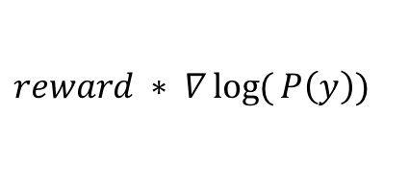
Learning with constraints
Standard Learning
minimizing negative log-likelihood
Learning with the reward:
Reward defined by our constraint.
$$reward ∗ ∇\log{(}P\left(y\right))$$
$θ$ (model)
X (Input )
Y (output)
Notes:
Throw in some neural network equations h_t = f(W*x_t)

Slide 98
Learning with constraints
Standard Learning
minimizing negative log-likelihood
Learning with the reward:
Reward defined by our constraint.
Challenge:
Which instances do we examine?
If we sample through model prob, we are likely to have high constraint violations.
$$reward ∗ ∇\log{(}P\left(y\right))$$
$θ$ (model)
X (Input )
Y (output)
Notes:
Throw in some neural network equations h_t = f(W*x_t)

Slide 99
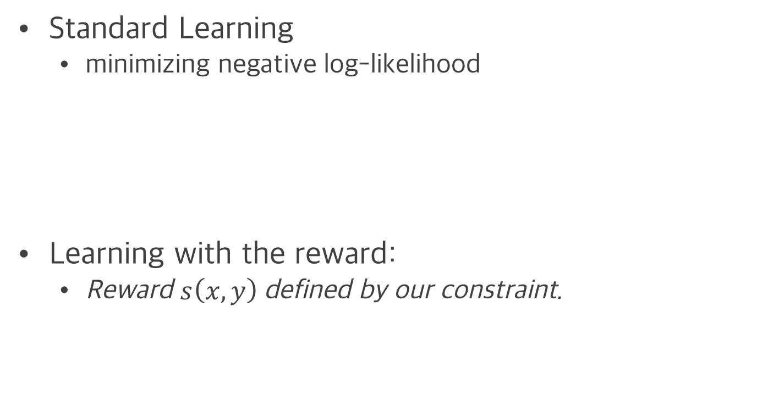
Learning with constraints
Standard Learning
minimizing negative log-likelihood
Learning with the reward:
Reward $s\left(x,y\right)$defined by our constraint.
REWARD
Notes:
Now reward can be positive or negative,
Comparison to GBI where it only penalizes,
This learning enables promotion of examples as well.

Slide 100
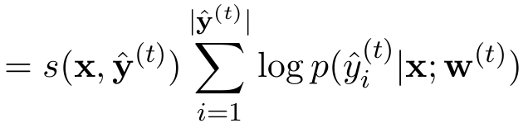
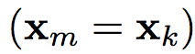
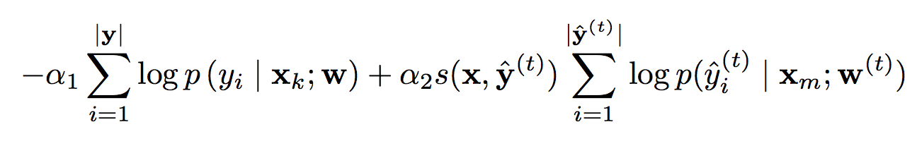
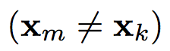
Learning with constraints
Learning with the reward s(x,y)
constraint loss
Joint loss
Semi-supervised Joint loss
SRL-labeled data
SRL-labeled data
SRL-labeled data
SRL-labeled data
SRL-labeled data
SRL-labeled data
SRL-labeled data
SRL-labeled data
SRL-labeled data
SRL-labeled data
SRL-labeled data
SRL-unlabeled data
SRL-unlabeled data
SRL-labeled data
SRL-unlabeled data
SRL-labeled data
SRL-unlabeled data
SRL-labeled data
SRL-unlabeled data
SRL-labeled data
SRL-unlabeled data
SRL-labeled data
SRL-unlabeled data
SRL-labeled data
SRL-unlabeled data
SRL-labeled data
SRL-unlabeled data
Notes:
Throw in some neural network equations h_t = f(W*x_t)

Slide 101
Learning with constraints
Learning with the reward s(x,y)
constraint loss
Joint loss
SRL-labeled data
SRL-labeled data
SRL-labeled data
SRL-labeled data
SRL-labeled data
SRL-labeled data
SRL-labeled data
SRL-labeled data
SRL-labeled data
SRL-labeled data
SRL-labeled data
SRL-unlabeled data
SRL-unlabeled data
SRL-labeled data
SRL-unlabeled data
SRL-labeled data
SRL-unlabeled data
SRL-labeled data
SRL-unlabeled data
SRL-labeled data
SRL-unlabeled data
SRL-labeled data
SRL-unlabeled data
SRL-labeled data
SRL-unlabeled data
SRL-labeled data
SRL-unlabeled data
Notes:
Figuratively speaking,

Slide 102
Learning with constraints
Learning with the reward s(x,y)
constraint loss (c-loss)
Joint loss
Labeled
Constraint
SRL-labeled data
SRL-labeled data
SRL-labeled data
SRL-labeled data
SRL-labeled data
SRL-labeled data
SRL-labeled data
SRL-labeled data
SRL-labeled data
SRL-labeled data
SRL-labeled data
SRL-unlabeled data
SRL-unlabeled data
SRL-labeled data
SRL-unlabeled data
SRL-labeled data
SRL-unlabeled data
SRL-labeled data
SRL-unlabeled data
SRL-labeled data
SRL-unlabeled data
SRL-labeled data
SRL-unlabeled data
SRL-labeled data
SRL-unlabeled data
SRL-labeled data
SRL-unlabeled data
Notes:
Throw in some neural network equations h_t = f(W*x_t)

Slide 103
Learning with constraints
Unlabeled
Learning with the reward s(x,y)
constraint loss (c-loss)
Joint loss
Constraint
Labeled
Constraint
SRL-labeled data
SRL-labeled data
SRL-labeled data
SRL-labeled data
SRL-labeled data
SRL-labeled data
SRL-labeled data
SRL-labeled data
SRL-labeled data
SRL-labeled data
SRL-labeled data
SRL-unlabeled data
SRL-unlabeled data
SRL-labeled data
SRL-unlabeled data
SRL-labeled data
SRL-unlabeled data
SRL-labeled data
SRL-unlabeled data
SRL-labeled data
SRL-unlabeled data
SRL-labeled data
SRL-unlabeled data
SRL-labeled data
SRL-unlabeled data
SRL-labeled data
SRL-unlabeled data
Notes:
Throw in some neural network equations h_t = f(W*x_t)

Slide 104
Learning with constraints
Learning with the reward s(x,y)
constraint loss (c-loss)
Joint loss
Semi-supervised Joint loss
Unlabeled
Labeled
Constraint
SRL-labeled data
SRL-labeled data
SRL-labeled data
SRL-labeled data
SRL-labeled data
SRL-labeled data
SRL-labeled data
SRL-labeled data
SRL-labeled data
SRL-labeled data
SRL-labeled data
SRL-unlabeled data
SRL-unlabeled data
SRL-labeled data
SRL-unlabeled data
SRL-labeled data
SRL-unlabeled data
SRL-labeled data
SRL-unlabeled data
SRL-labeled data
SRL-unlabeled data
SRL-labeled data
SRL-unlabeled data
SRL-labeled data
SRL-unlabeled data
SRL-labeled data
SRL-unlabeled data
Notes:
Throw in some neural network equations h_t = f(W*x_t)

Slide 105
Learning with constraints
Learning with the reward s(x,y)
constraint loss (c-loss)
Joint loss
Semi-supervised Joint loss
Unlabeled
Constraint
Labeled
Constraint
Unlabeled
Labeled
Constraint
SRL-labeled data
SRL-labeled data
SRL-labeled data
SRL-labeled data
SRL-labeled data
SRL-labeled data
SRL-labeled data
SRL-labeled data
SRL-labeled data
SRL-labeled data
SRL-labeled data
SRL-unlabeled data
SRL-unlabeled data
SRL-labeled data
SRL-unlabeled data
SRL-labeled data
SRL-unlabeled data
SRL-labeled data
SRL-unlabeled data
SRL-labeled data
SRL-unlabeled data
SRL-labeled data
SRL-unlabeled data
SRL-labeled data
SRL-unlabeled data
SRL-labeled data
SRL-unlabeled data
Notes:
Throw in some neural network equations h_t = f(W*x_t)

Slide 106
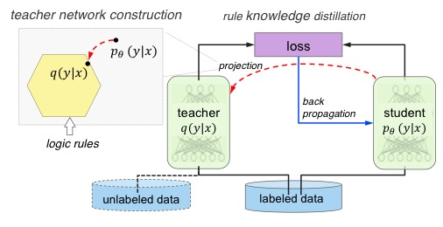
Related Work
Ganchev et al., 2010, Hinton et al., 2016, Hu et al., (ACL2016, EMNLP2016, NIPS2018),
Posterior regularization (PR) has a similar form as an joint objective.
The philosophy is different as I directly give reward to outputs whereas PR will make a soft logit vector from the constraints.
One drawback of this is that the base distribution P(.) is only stable for problems that current output does not depend on previous output (no seq2seq). (Hu 2016)

Slide 107
Research Questions
Q1. Does proposed method actually enforce constraints?
Q2. Does proposed method enforce constraints without compromising the quality of the system?
Q3. How well does SSL formulation perform, especially in low-resource scenarios?
Q4. Is the train time & decoding time effort mutually exclusive? (training time vs. decoding time ?)

Slide 108
SRL Experiments (again)
OntoNotes v5.0, CoNLL-2012 shared task (278k train, 38.3k dev, 25.6k test)
Gold predicates and gold parse constituents are given (~10% noisy annotations) .
Baseline architecture
multi-layer highway bi-directional LSTM (ELMo embedding)

Slide 109
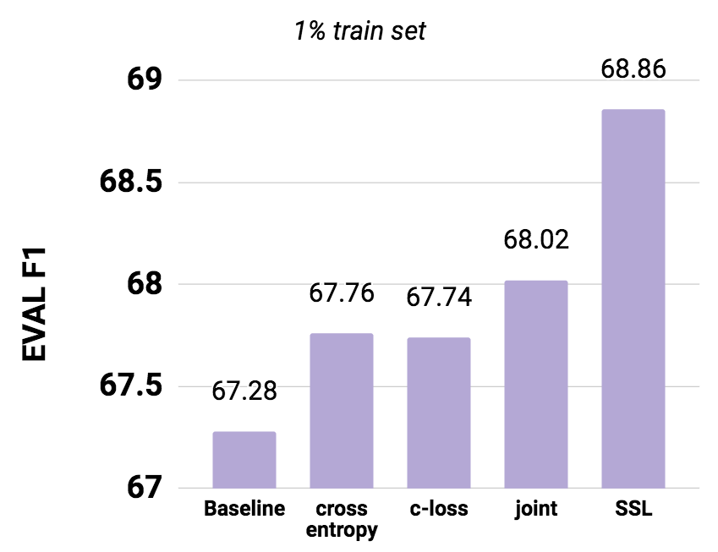
Comparison of losses (on 1%)
Notes:
Throw in some neural network equations h_t = f(W*x_t)

Slide 110
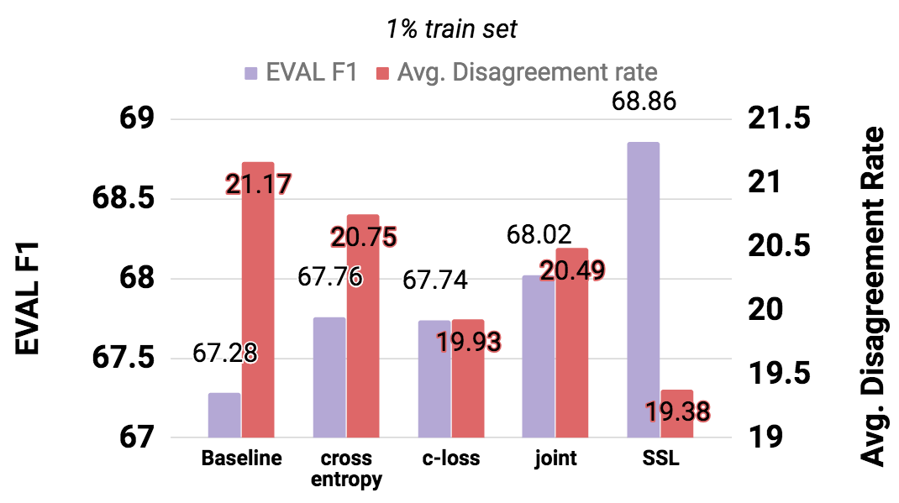
Comparison of losses (on 1%)
Notes:
Throw in some neural network equations h_t = f(W*x_t)

Slide 111
Comparison of losses (on 1%)
All the loss
function answer Q2-4 favorably!
Q2. enforce constraints,
Q3. enforce constraints without compromising the quality,
Q4. SSL formulation perform well?
Notes:
Throw in some neural network equations h_t = f(W*x_t)

Slide 112
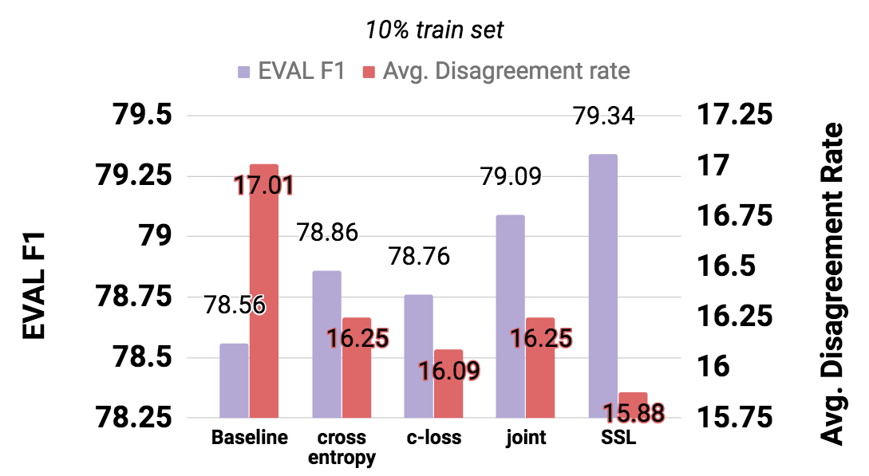
Comparison of losses (on 10%)
Notes:
Throw in some neural network equations h_t = f(W*x_t)

Slide 113
Comparison of losses (on 10%)
Similar trend.
Again, answers Q2-4 Favorably!
Q2. enforce constraints,
Q3. enforce constraints without compromising the quality,
Q4. SSL formulation perform well?
Notes:
Throw in some neural network equations h_t = f(W*x_t)

Slide 114
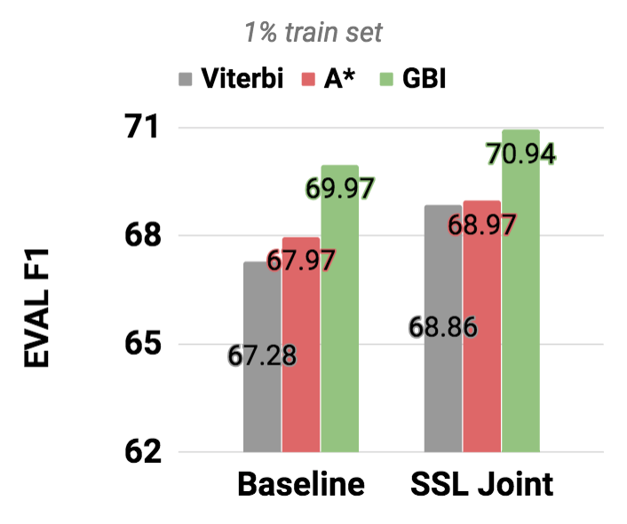
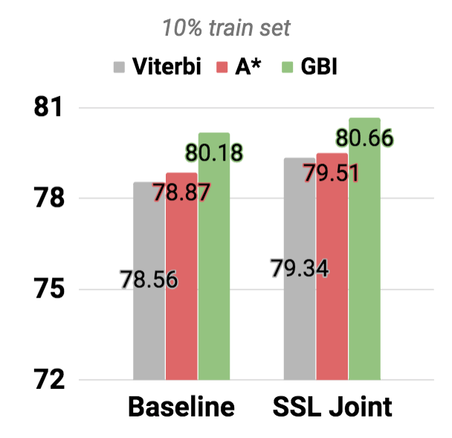
Q5 train & test are complementary?
On 1% dataset: GBI brings additional gains on top of train-time constraint injection.
Notes:
Delete A*

Slide 115
Q5 train & test are complementary?
On 1% dataset: GBI brings additional gains on top of train-time constraint injection.
+2.08
+1.32
+2.69
+2.69
+0.17
+0.11
+0.31
+0.69
Notes:
Significantly small improvement in A*

Slide 116


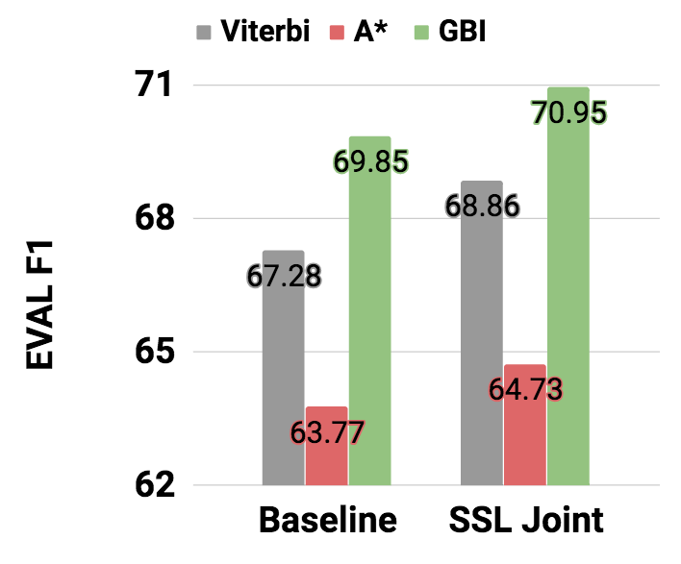
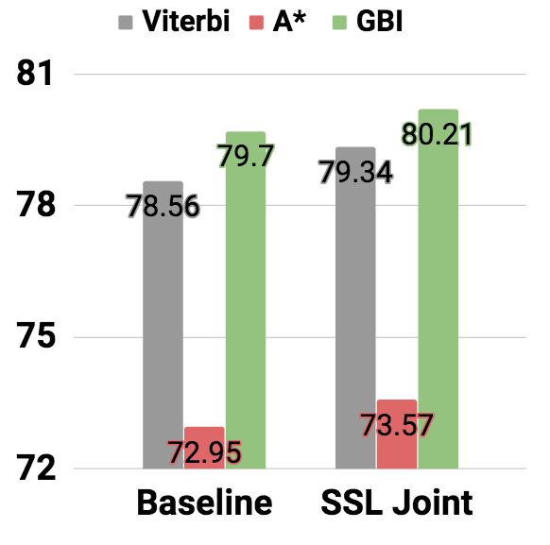
Q5 Constraints on train vs. test.
Both on 1, 10%: GBI brings additional gains on top of train-time constraint injection.
Noisy constraint

Slide 117
Summary: Learning with constraints
Q1. Does proposed method actually enforce constraints?
Yes!
Q2. Does proposed method enforce constraints without compromising the quality of the system?
Yes, and improves as GBI did.
Q3. How well does SSL formulation perform, especially in low-resource scenarios?
It works the best out of all the losses proposed.
Q4. Is the train time & decoding time effort mutually exclusive? (training time vs. decoding time ?)
No! The efforts add up. The two are complementary.

Slide 118
Summary on completed work
Constraint Injection (ancillary objective)
Output constraint “satisfaction”
Main performance Improvement
GBI is faster & better than A* algorithm.
By leveraging “constraints” that do not require labels
Better performance on out of domain
Semi-Supervised Learning
[Proposed] Domain adaption (unlabeled target)

Slide 119
Conclusion
Explored constraint function
Aggregate (sum) constraint function.
Transduction problem.
Constraint occurring from representation.
Brackets from parsing
Syntactic constraint from linguistic knowledge.
Semantic Role Labeling.
General constraints
No differentiability requirement.
Simple (normalized) count of errors work.
Model-agnostic
Only changed “loss” function.
No separate feature engineering nor network structure change.
Formulation-wise, it can even extend to vastly different applications. (multi-modal)
‘Anyone’ can easily apply constraint.
Can quickly test out constraint using GBI.
The loss on GBI and Learn-time are similar
Examine potential effect of constraint injection with GBI before training another model.

Slide 120
Roadmap
Motivations & Background
Inference with constraints
Learning with constraints
Proposed work
Application
new methods (exploration)
Completed
Work
Proposed Work
Notes:
문제정의와 proposed method를 정의하고,
구체적으로 어떻게 풀 수 있는지 제가 참여하고 있는 Boeing project의 예를 들어 설명드리겠습니다.

Slide 121
[App 1] Domain adaptation
Leveraging unlabeled data
train on ‘source’ domain → target domain
Source
Domain
Target
Domain
Notes:
A bit of explanation on imitation learning

Slide 122
[App 1] Domain adaptation
Leveraging unlabeled data
train on ‘source’ domain → target domain
Improve the target domain performance via constraint
Source
Domain
Knowledge/ Constraint
Target
Domain
Notes:
A bit of explanation on imitation learning

Slide 123
CoNLL2012 domain again
CoNLL2012
NewsWire (NW) which includes WSJ
Broadcast Conversation (BC)
Broadcast News (BN)
Pivot Corpus (PT)
Telephone Conversation (TC)
Weblogs (WB)
Source
Domain
Constraint
Target
Domain
Can constraint injection
transfer to other domains?
Notes:
Throw in some neural network equations h_t = f(W*x_t)

Slide 124
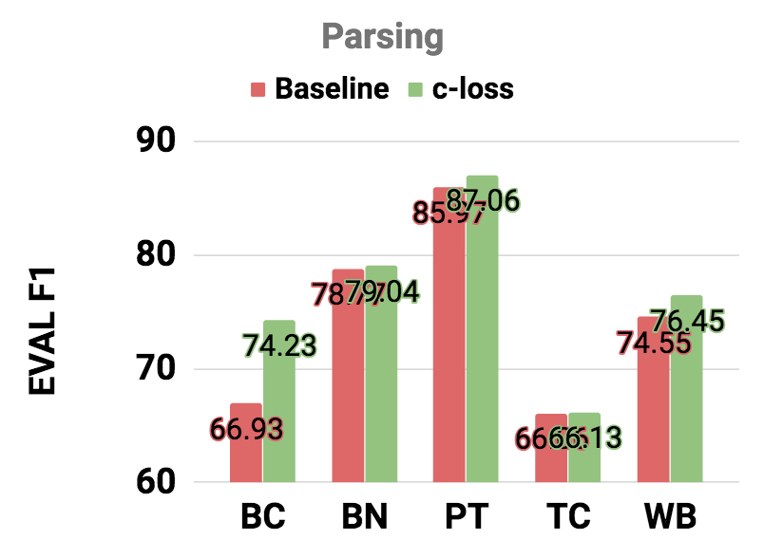
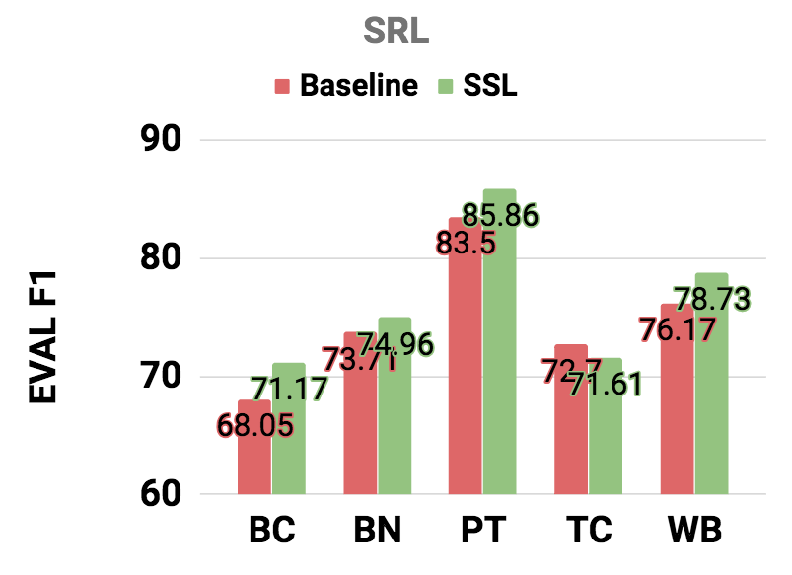
Preliminary Experiment
Parsing with c-loss (constraint violation loss)
SRL with SSL joint loss.
Notes:
But other comparison to related to works are and engineering efforts are still in need.
If there is proper domain distinction rather than just inside the CoNLL2012 datset,
It would be great.

Slide 125
[App 2] “Any” span-based application
There is no SRL-specific component to the earlier “learning with constraints”.
Would this approach work on “general” span-based model?
Co-reference resolution
Framenet SRL
Shallow Discourse Parsing
…
Unlabeled
Knowledge/ Constraint
Labeled

Slide 126
[App 2] “Any” span-based application
Challenges to “Any” span-based models.
New models that considers all the possible spans.
Questions to ask
How well would current approach work on new models?
Do we need other ways to inject knowledge?
SOTA work
Still focuses on the gold labels only.
Unlabeled
Knowledge/ Constraint
Labeled

Slide 127
Roadmap
Motivations & Background
Inference with constraints
Learning with constraints
Proposed work
Application
new methods (exploration)
Completed
Work
Proposed Work
Notes:
문제정의와 proposed method를 정의하고,
구체적으로 어떻게 풀 수 있는지 제가 참여하고 있는 Boeing project의 예를 들어 설명드리겠습니다.

Slide 128
[Method 1] Negative sampling
Learning with constraint, we tried to find the best output given model.
Evaluate ‘how well (bad)’ the output is in terms of the constraint violation. → Use this signal to further train.
Can we do better?
Can we systematically sample constraint violating sets and learn from it?
Challenges:
Sampling a sequence (sentence) with a score distribution is not straightforward.
Proposed method: Sampling using MCMC method.
How to learn from the negatvie samples?
Proposed method: Max-margin training
Notes:
A bit of explanation on imitation learning

Slide 129
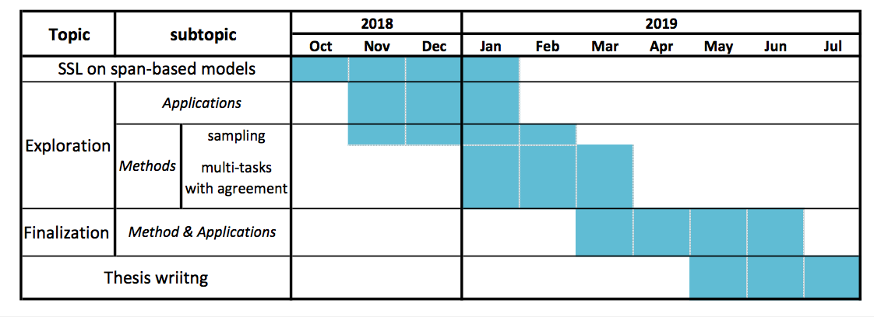
Proposed Timeline

Slide 130
Thank You!
Questions?
Notes:
저는 deep learning을 통해 자동차의 이상징후들을 미리 예견할 수 있는 머신러닝 모델을 제안하고자 합니다.

Slide 131
Backup slides
181. Shift-Reduce syntax
193. Case study of GBI on parsing

Slide 132

[Revisit] Complex models
Semantic Role Labeling
$θ$ (model)
X (Input )
The cat
loves hats
Y (output)
VERB – love
ARG0 – the cats
ARG1– hats
Slide credits: Luheng He

Slide 133
Deep Learning: sequence data
Long Short Term Memory (LSTM) Deep Learning (RNN) tool for analyzing sequence data.
Success in sequence-to-sequence model. Sequence data를 abstract하게 표현할 수 있는 능력.
Encoder
LSTM
Decoder
LSTM
Notes:
Throw in some neural network equations h_t = f(W*x_t)

Slide 134
Deep Learning: sequence data
Long Short Term Memory (LSTM) Deep Learning (RNN) tool for analyzing sequence data.
Success in sequence-to-sequence model. Sequence data를 abstract하게 표현할 수 있는 능력.
Encoder
Decoder
Have a great day!
좋은 하루 보내세요!
Notes:
Throw in some neural network equations h_t = f(W*x_t)

Slide 135
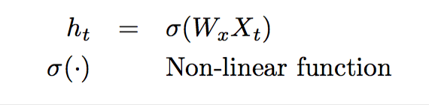
Deep Learning: sequence data
Long Short Term Memory (LSTM) Deep Learning (RNN) tool for analyzing sequence data.
Standard Neural Network
h_{t}
A
X_{t}
Notes:
Throw in some neural network equations h_t = f(W*x_t)

Slide 136
Deep Learning: sequence data
Long Short Term Memory (LSTM) Deep Learning (RNN) tool for analyzing sequence data.
Standard Neural Network
h_{t}
NN를 정의
A
X_{t}
Notes:
Throw in some neural network equations h_t = f(W*x_t)

Slide 137
Deep Learning: LSTM
Long Short Term Memory (LSTM) Deep Learning (RNN) tool for analyzing sequence data.
Standard Neural Network
h_{t}
h_{t}
A₂
A
A₁
X_{t}
X_{t}
Notes:
Throw in some neural network equations h_t = f(W*x_t)

Slide 138
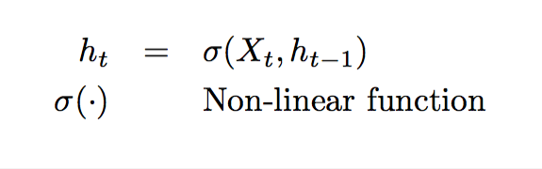
Deep Learning: LSTM
Long Short Term Memory (LSTM) Deep Learning (RNN) tool for analyzing sequence data.
Recurrent Neural Network (RNN)
h_{t}
A
X_{t}
Notes:
과거의 h(t-1)이용.

Slide 139
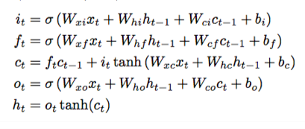
Deep Learning: LSTM
DETAIL
Long Short Term Memory (LSTM) Deep Learning (RNN) tool for analyzing sequence data.
Recurrent Neural Network (RNN)
h_{t}
A
X_{t}
Notes:
Throw in some neural network equations h_t = f(W*x_t)

Slide 140
Deep Learning: LSTM
DETAIL
Long Short Term Memory (LSTM) Deep Learning (RNN) tool for analyzing sequence data.
Recurrent Neural Network (RNN)
h_{t}
A
X_{t}
Notes:
Throw in some neural network equations h_t = f(W*x_t)

Slide 141
Deep Learning: LSTM
Long Short Term Memory (LSTM) Deep Learning (RNN) tool for analyzing sequence data.
h_{t}
h₀
h₁
h₂
h_{t}
A
=
A
A
A
…
A
`
X_{t}
X₁
X₂
X₃
X_{t}
Notes:
Power: model parameter가 same
Variable length의 모델링이 가능.

Slide 142
Deep Learning: LSTM
Long Short Term Memory (LSTM) Deep Learning (RNN) tool for analyzing sequence data.
h_{t}
h₀
h₁
h₂
h_{t}
…
A
=
A
A
A
…
A
`
X_{t}
X₁
X₂
X₃
…
X_{t}
Notes:
Memory cell 이

Slide 143
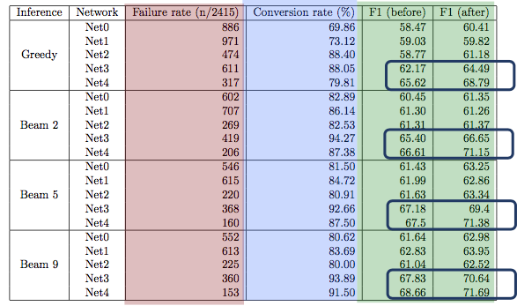
Application1: Syntactic Parsing
Experiments

Slide 144
Representation Learning
DETAIL
h_{t}
Single unit 을 자세히 보면,
A
X_{t}

Slide 145
Representation Learning
DETAIL
h_{t}
Single unit 을 자세히 보면,
defines Network
A
X_{t}

Slide 146
GBI on
Shift-redcue syntax

Slide 147
How to express the Grammar Tree as a sequence?
Proposed model
“As a command” to produce the tree.
Shift-Reduce syntax
Bottom-up approach
Similar to how human minds work.
S
NP
VP
.
John
has
NP
a
dog

Slide 148
How to express the Grammar Tree as a sequence?
Proposed model
“As a command” to produce the tree.
s R-1-NP s s s R-2-NP R-2-VP s R-3-S
Shift-Reduce syntax
s corresponds to “push” in stack.
R-#-XX corresponds to “pop”-ing that # of elements , merging them together to XX, and pushing it back to the stack.
S
NP
VP
.
John
has
NP
a
dog
Notes:
I am going to show an example of shift-reduce syntax
But without all the details, the take away from here is that you can linearize the parse tree
Into corresponding shift-reduce commands.

Slide 149
Shift-Reduce syntax
Proposed model
Original sentence John has a dog .
Shift-Reduce command s R-1-NP s s s R-2-NP R-2-VP s R-3-S

Slide 150
Shift-Reduce syntax
Proposed model
Original sentence John has a dog .
Shift-Reduce command s R-1-NP s s s R-2-NP R-2-VP s R-3-S
John

Slide 151
Shift-Reduce syntax
Proposed model
Original sentence John has a dog .
Shift-Reduce command s R-1-NP s s s R-2-NP R-2-VP s R-3-S
(NP John)

Slide 152
Shift-Reduce syntax
Proposed model
Original sentence John has a dog .
Shift-Reduce command s R-1-NP s s s R-2-NP R-2-VP s R-3-S
has
(NP John)

Slide 153
Shift-Reduce syntax
Proposed model
Original sentence John has a dog .
Shift-Reduce command s R-1-NP s s s R-2-NP R-2-VP s R-3-S
a
has
(NP John)

Slide 154
Shift-Reduce syntax
Proposed model
Original sentence John has a dog .
Shift-Reduce command s R-1-NP s s s R-2-NP R-2-VP s R-3-S
dog
a
has
(NP John)

Slide 155
Shift-Reduce syntax
Proposed model
Original sentence John has a dog .
Shift-Reduce command s R-1-NP s s s R-2-NP R-2-VP s R-3-S
dog
a
has
(NP John)

Slide 156
Shift-Reduce syntax
Proposed model
Original sentence John has a dog .
Shift-Reduce command s R-1-NP s s s R-2-NP R-2-VP s R-3-S
(NP a dog)
has
(NP John)

Slide 157
Shift-Reduce syntax
Proposed model
Original sentence John has a dog .
Shift-Reduce command s R-1-NP s s s R-2-NP R-2-VP s R-3-S.
(VP has (NP a dog) )
(NP John)

Slide 158
Shift-Reduce syntax
Proposed model
Original sentence John has a dog .
Shift-Reduce command s R-1-NP s s s R-2-NP R-2-VP s R-3-S
.
(VP has (NP a dog) )
(NP John)

Slide 159
Shift-Reduce syntax
Proposed model
Original sentence John has a dog .
Shift-Reduce command s R-1-NP s s s R-2-NP R-2-VP s R-3-S
.
(VP has (NP a dog) )
(NP John)

Slide 160
Shift-Reduce syntax
Proposed model
Original sentence John has a dog
Shift-Reduce command s R-1-NP s s s R-2-NP R-2-VP s R-3-S
(S (NP John) (VP has (NP a dog) ) .)
Notes:
We just established that shift-reduce syntax can express the parse tree.
Do not confuse this with the
(DON’T READ THIS)
At this point, one might say why not just use the orange box,
Which is totally valid thinking to do.
we CHOSE shift-reduce commands, because we think it has simpler representation.
Not gonna go into details of why it’s simpler.
But I do want to give you a little background.
This project started as multi-lingual transfer learning problem.

Slide 161
GBI on
GBI case study

Slide 162
Case study of GBI on parsing
Comparison to decoder with constraints on each step.
Unconstrained decoding + Error signal propagation can be more powerful.
Notes:
(S (NP xx) (VP xx(NP xx xx))

Slide 163
GBI on
GBI runtime

Slide 164
GBI runtime [WIP]
On CoNLL 2012 propbank (25k sentence, predicate pairs)
Viterbi: 2 hours. (baseline)
A*: 20 hours (F1 +0.11 … +0.69)
GBI: 12 hours (F1 +1.23 … +2.69) with max epoch 10
There is a small trade-off between max epoch
max epoch 30 compared with GBI with max epoch of 10
F1 overall (+0.34)
F1 on failure set (+3.4)
exact match (+4.35%)
conversion rate (+11.24%)
Runtime ~ 12 hours.
Detailed analysis left for [Proposed work]
Notes:
0.11-0.69
1.23-2.69

Slide 165
GBI runtime [WIP]
On CoNLL 2012 propbank (25k sentence, predicate pairs)
Viterbi: 2 hours. (baseline)
A*: 20 hours (F1 +0.11 … +0.69)
GBI: 12 hours (F1 +1.23 … +2.69) with max epoch 10
There is a small trade-off between max epoch
max epoch 30 compared with GBI with max epoch of 10
F1 overall (+0.34)
F1 on failure set (+3.4)
exact match (+4.35%)
conversion rate (+11.24%)
Runtime ~ 12 hours.
Detailed analysis left for [Proposed work]
Notes:
0.11-0.69
1.23-2.69

Slide 166
GBI extra experiment [WIP]
SRL has the following constraints
BIO – captured by vitrebi
Syntactic consistency
U,C,R violation
Unique core (U) / Continuation (C) / Reference (R) roles
SOTA models have UCR violations
GBI successfully reduces U,C,R violations.
No F1 score improvement, but the side effect of U,C,R is still unstudied as SRL output is used as an input to the following system.
WORK IN PROGRESS
Notes:
0.11-0.69
1.23-2.69

Slide 167
GBI on Transduction [WIP]
Application 3: Transduction problem
Definition
A transducer T : L_s → L_t is a function from a source language to a target language
Transduction itself is a difficult problem.
We use it as an example of constraint with seq2seq problem, when you know the aggregate information.
Transduction rule: az → aaa
Notes:
. In our experiment, we employ a known T to generate input/output training examples and train a sequence-to-sequence network to learn T on that data.

Slide 168
GBI on Transduction
Case study of GBI on transduction problem.
Notes:
Throw in some neural network equations h_t = f(W*x_t)

Slide 169
GBI on Transduction
Results on Transduction
[Work in progress]
Shows that GBI can work with hard constraints on general seq2seq model.
Notes:
Throw in some neural network equations h_t = f(W*x_t)

Slide 170
GBI on
Parsing slides

Slide 171
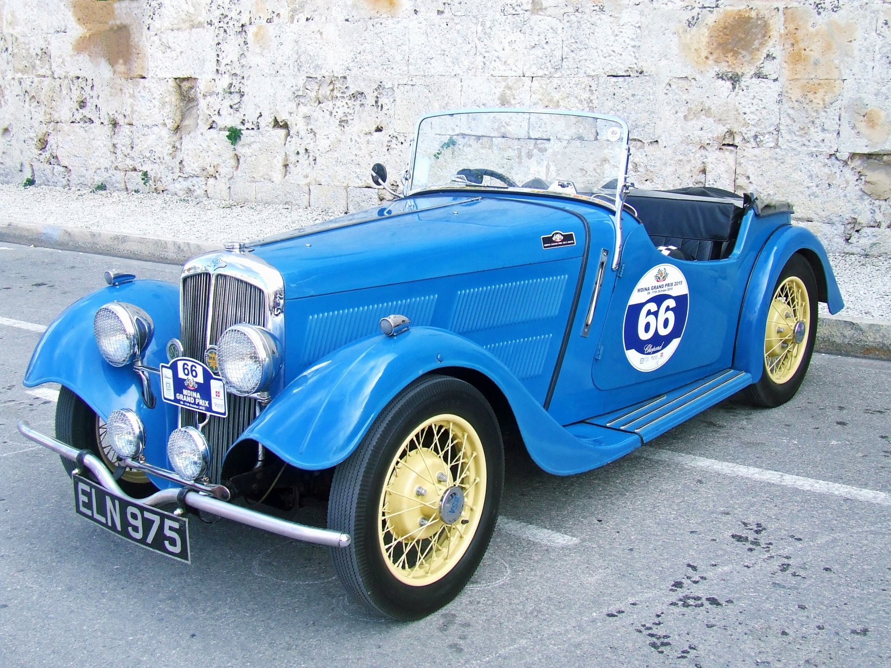
GBI on Syntactic Parsing
Application 2: Syntactic constituency parsing.
One of the fundamental problem studied in NLP for decades.
Provides structure to NLP tasks.
Sentiment analysis, Translations, Named Entity Recognitions, ….
NP
NP
blue car (en)
voiture bleue (fr)
Notes:
A bit of explanation on imitation learning

Slide 172

GBI on Syntactic Parsing
Application 2: Syntactic constituency parsing.
One of the fundamental problem studied in NLP for decades.
Provides structure to NLP tasks.
Sentiment analysis, Translations, Named Entity Recognitions, ….
e.g.) “This film does not care about cleverness, wit or any other kind of intelligent humor" (Socher et al EMLNP 2013)
Bag of Words
Notes:
A bit of explanation on imitation learning

Slide 173

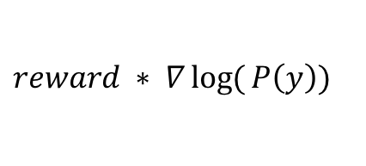
Learning with constraints
Optimization with constraints
Learning with the reward:
Reward defined by our constraint.
$$reward ∗ ∇\log{(}P\left(y\right))$$
$θ$ (model)
X (Input )
Y (output)
Notes:
Throw in some neural network equations h_t = f(W*x_t)

Slide 174
Learning with constraints
Learning with the reward:
the equations
Present three types of equations we can use.
OutpuPut t inconsistency (OI) loss definition
Simple GBI to batch-learning.
Joint loss: supervised + OI-loss
Semi-supervised joint loss: supervised + OI-loss
Fix the notations s→ g, SI → OI
Notes:
Throw in some neural network equations h_t = f(W*x_t)

Slide 175
GBI on
GBI in detail

Slide 176
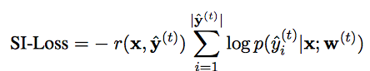
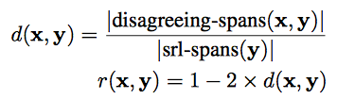
Learning with constraints
DETAIL
Proposed methods
Output inconsistency (OI-Loss)

Slide 177
Learning with constraints
DETAIL
Proposed methods
syntactic inconsistency (SI-Loss)
REWARD

Slide 178
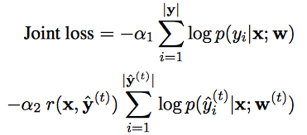
Learning with constraints
DETAIL
Proposed methods
Joint Loss

Slide 179
Learning with constraints
DETAIL
Proposed methods
Joint Loss
Supervision
Guided by constraint

Slide 180
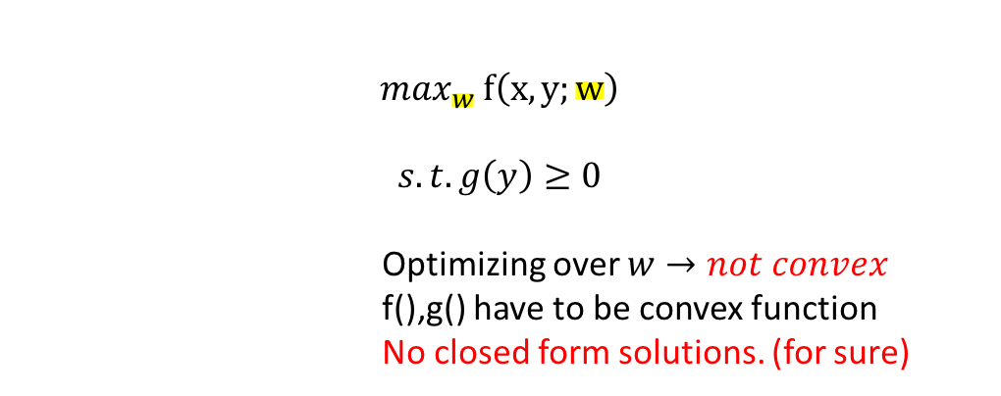

Problem Definition
Is neural model good enough?
LARGE dataset is required.
Not very good on small dataset. (Data-deficiency problem)
End-to-End learning
often ignores the constraints on the output space.
Hard to inject knowledge/constraints.
Standard optimization Neural Network
$$\max_{y} f\left(x, y;w\right)$$
$$s.t. g\left(y\right)≥0$$
Optimizing over y $→convex$
$$\max_{w} f\left(x,y;w\right)$$
$$s.t. g\left(y\right)≥0$$
Optimizing over $w→not convex$
f(),g() have to be convex function
No closed form solutions. (for sure)
Notes:
운전 중에 발생한 오작동으로 인한 위기
차를 움직이지 못하는 불편함의 가능성
운전 가능시에도 위험요소를 안고 운전해야 하는 등의 여러가지 위험, 불편이 동반됩니다.
하나의 부품만 보는 형식은
자동차의 구조적 dependency를 무시.
제가 제안하는 방식은,

Slide 181
Gradient-Based Inference (GBI)
Motivation
Modified Lagrangian Relaxation
Gradient-Based Inference
Likelihood
Constraint violation
Notes:
Throw in some neural network equations h_t = f(W*x_t)

Slide 182
Gradient-Based Inference (GBI)
Motivation
Modified Lagrangian Relaxation
Gradient-Based Inference
Regularizer
Notes:
A bit of explanation on imitation learning

Slide 183
Gradient-Based Inference (GBI)
Motivation
Optimization with constraints
Standard Lagrangian Relaxation
Notes:
Throw in some neural network equations h_t = f(W*x_t)

Slide 184
Gradient-Based Inference (GBI)
Motivation
Optimization with constraints
Standard Lagrangian Relaxation
Modified Lagrangian Relaxation
Likelihood
Constraint violation
Notes:
Constraints that are not localized.

Slide 185
Gradient-Based Inference (GBI)
Motivation
Standard Lagrangian Relaxation
Gradient-Based Inference
Notes:
change it to intuition
Proposed model

Slide 186
Gradient-Based Inference (GBI)
Motivation
Modified Lagrangian Relaxation
Gradient-Based Inference
Notes:
Throw in some neural network equations h_t = f(W*x_t)

Slide 187
Gradient-Based Inference (GBI)
Motivation
Modified Lagrangian Relaxation
Gradient-Based Inference
Likelihood
Constraint violation
Notes:
Throw in some neural network equations h_t = f(W*x_t)

Slide 188
Gradient-Based Inference (GBI)
Motivation
Modified Lagrangian Relaxation
Gradient-Based Inference
Regularizer
Notes:
A bit of explanation on imitation learning

Slide 189
Gradient-Based Inference (GBI)
Optimization with constraints
Gradient-Based Inference (in math)
Notes:
Throw in some neural network equations h_t = f(W*x_t)

Slide 190
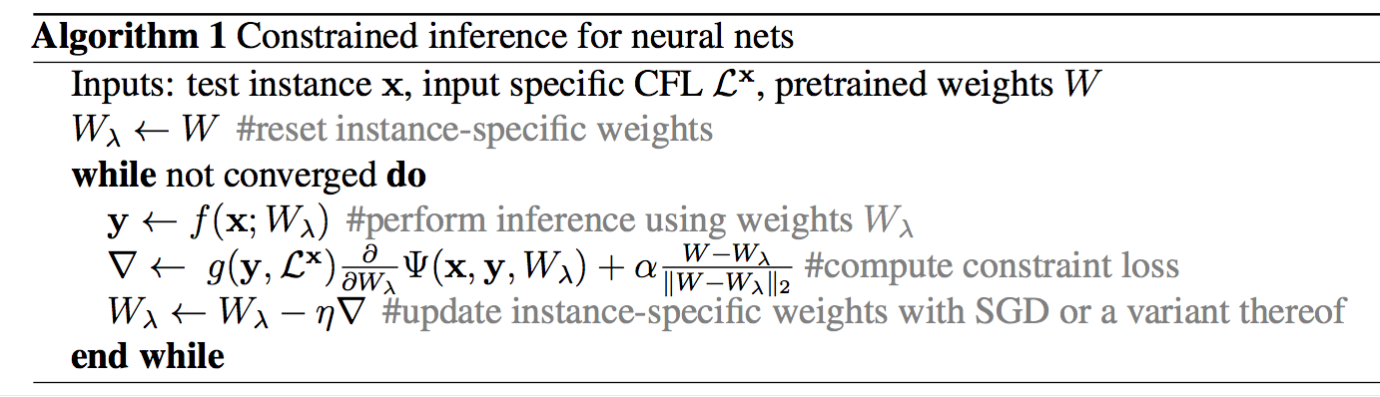
Gradient-Based Inference (GBI)
DETAIL
GBI (in Algorithm)
Initiate as model weight
Jay Yoon Lee et al, Gradient-based Inference for Networks with Output Constraint, AAAI 2019

Slide 191
Gradient-Based Inference (GBI)
DETAIL
GBI (in Algorithm)
Jay Yoon Lee et al, Gradient-based Inference for Networks with Output Constraint, AAAI 2019

Slide 192
Gradient-Based Inference (GBI)
DETAIL
GBI (in Algorithm)
Jay Yoon Lee et al, Gradient-based Inference for Networks with Output Constraint, AAAI 2019
Notes:
A bit of explanation on imitation learning

Slide 193
Gradient-Based Inference (GBI)
DETAIL
GBI (in Algorithm)
Reset for new instance
Jay Yoon Lee et al, Gradient-based Inference for Networks with Output Constraint, AAAI 2019
Notes:
A bit of explanation on imitation learning

Slide 194
GBI on Parsing
Preliminary

Slide 195
Preliminary Experiment: Parsing
Initial Results ( NO knowledge injection)
Notes:
A bit of explanation on imitation learning

Slide 196
Preliminary Experiment: Parsing
Improvements
Notes:
A bit of explanation on imitation learning

Slide 197
GBI on Parsing
Motivations

Slide 198
Motivation
Is neural model good enough?
Notes:
운전 중에 발생한 오작동으로 인한 위기
차를 움직이지 못하는 불편함의 가능성
운전 가능시에도 위험요소를 안고 운전해야 하는 등의 여러가지 위험, 불편이 동반됩니다.
하나의 부품만 보는 형식은
자동차의 구조적 dependency를 무시.
제가 제안하는 방식은,

Slide 199

Motivation
Is neural model good enough?
Not very well performing on small dataset.

Slide 200
Motivation
Is neural model good enough?
Not very good on small dataset.
LARGE dataset is required. (Data-deficiency problem)
End-to-End learning
Better Performance? Yes. Perfect? No.
often ignores the constraints on the output space.

Slide 201
Motivation
Is neural model good enough?
Not very good on small dataset.
LARGE dataset is required. (Data-deficiency problem)
End-to-End learning
often ignores the constraints on the output space.
Hard to inject knowledge/constraints.
Non-differentiable constraints (rules)
Besides gold-labels, which instances should we explore?
Notes:
운전 중에 발생한 오작동으로 인한 위기
차를 움직이지 못하는 불편함의 가능성
운전 가능시에도 위험요소를 안고 운전해야 하는 등의 여러가지 위험, 불편이 동반됩니다.
하나의 부품만 보는 형식은
자동차의 구조적 dependency를 무시.
제가 제안하는 방식은,

Slide 202
Motivation
Is neural model good enough?
Not very good on small dataset.
LARGE dataset is required. (Data-deficiency problem)
End-to-End learning
often ignores the constraints on the output space.
Hard to inject constraints.
The constraint I refer to are usually rules.
More violations on out-of-domain data.
Notes:
운전 중에 발생한 오작동으로 인한 위기
차를 움직이지 못하는 불편함의 가능성
운전 가능시에도 위험요소를 안고 운전해야 하는 등의 여러가지 위험, 불편이 동반됩니다.
하나의 부품만 보는 형식은
자동차의 구조적 dependency를 무시.
제가 제안하는 방식은,

Slide 203
GBI on Parsing
GBI on Parsing

Slide 204
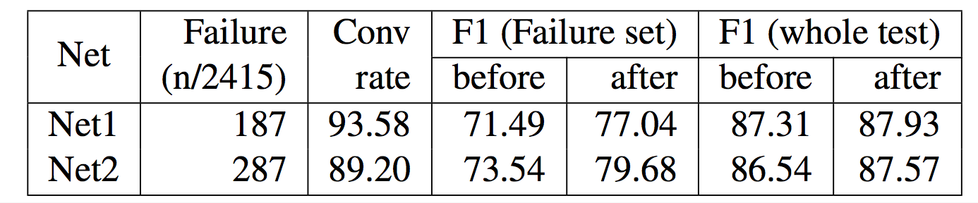
GBI on parsing: Experiments
Q1: Baseline’s performance on constraint satisfaction.
On best model: 7.8%, 11.8%
Notes:
A bit of explanation on imitation learning

Slide 205
GBI on parsing: Experiments
Q2: GBI enforces constraints.
Notes:
A bit of explanation on imitation learning

Slide 206
GBI on parsing: Experiments
Q3: GBI enforces constraints without hurting the system.
As well as SRL, it improves the overall system performance

Slide 207
GBI on parsing: Experiments
Q4: Not sensitive to the baseline model performance
Notes:
A bit of explanation on imitation learning

Slide 208
GBI on parsing: Experiments
Q4: Not sensitive to the baseline model performance.
Not only that, GBI also compatible with various decoding methods.
Notes:
A bit of explanation on imitation learning

Slide 209
GBI on Parsing
Related Work

Slide 210
Posterior Regularization & Distillation
Ganchev et al., 2010, Hu et al., (ACL2016, EMNLP2016, NIPS2018), Hinton et al, 2016
Using posterior regularization,
The base distribution is only stable for problems that current output does not depend on previous output (no seq2seq). (Hu 2016)
Different way of injecting score. (Mine is direct score of rules whereas PR samples from base probability times exponentiated payoff function.
Also, sampling (Hu 2018) from q distrbution is required, not easy to do for complicated structures.
The NIPS2018 paper does importance sampling with MC sampling on normalization factor. (The author told me that he only samples 5 times)
The distribution changes constantly, and not sure how well 5 step MC step will approximate normalization factor.
sampling

